Slide 1
Clinic Admin Project Training
Lisa Woodill
Director of Pharmacy Practice

Slide 2
Agenda
Appointment based pharmacy: Purpose and Vision
Project overview
Types of appointments
Pharmacist Scopes of Practice
Point of Care Testing
Ordering Lab Tests
Vaccines
Clinic Resources
Clinic Admin Role Booking Appointments
Clinic Admin Role Patient Check-in
Clinic patients
Workflow
Clinical resources
Clinic Administrator Role: Booking, Checkin, Post appointment
Data collection
Clinic Admin: Other duties
Clinic Admin: Checklist

Slide 3
Project Overview
The Community Pharmacy Primary Care Clinic (CPPCC) Demonstration Project was launched on February 1st, 2022. The project began with 12 clinic sites which expanded to include an additional 13 sites as of November, 2023, 6 Lawtons PWIC+ sites joined the project June, 2024 and NS Government just announced an additional 14 sites will be added September/October 2024 for a total of 45 sites across Nova Scotia.
Pharmacies are providing appointment-based services for all primary care services that are within the pharmacist scope of practice. This includes same day/next day appointments at all sites and released the day before/morning of for acute conditions.
A pharmacy clinic admin assistant is hired/re-deployed to support clinic activities as well as project documentation, ensuring the pharmacist is maximizing patient appointment time.
Based on demand in the geographical area and available staff, some clinic have been approved to provide care 20 to 60 hours a week which includes a mixture of days, nights and weekend hours (# of hours varies by location)

Slide 4
Appointment based pharmacy: Purpose and Vision
Purpose
Move from on-demand pharmacy services to appointment-based pharmacy services
Improves patient care and access to care at a larger scale in the pharmacy
Establish a more predictable workload that aligns with staffing
Decrease work related stress
Vision
The pharmacy team established specific windows, where non-dispensing pharmacy services will be provided.
Everyone on the team knows of the available appointments.
Everyone on the team knows what to say to the public in advance of moving to appointment-based pharmacy and when faced with a request for a service.
The pharmacist providing the service has everything prepared (e.g. forms available, SHARE data downloaded) before the service.
The team knows roles and responsibilities before the service, during the service and after the service.
Minimize administrative functions by the pharmacist during the service.
Focus on efficiency so that there is no duplication of work when providing the service.
As the team increases in confidence and technical efficiency in providing services, the scale of services increases

Slide 5
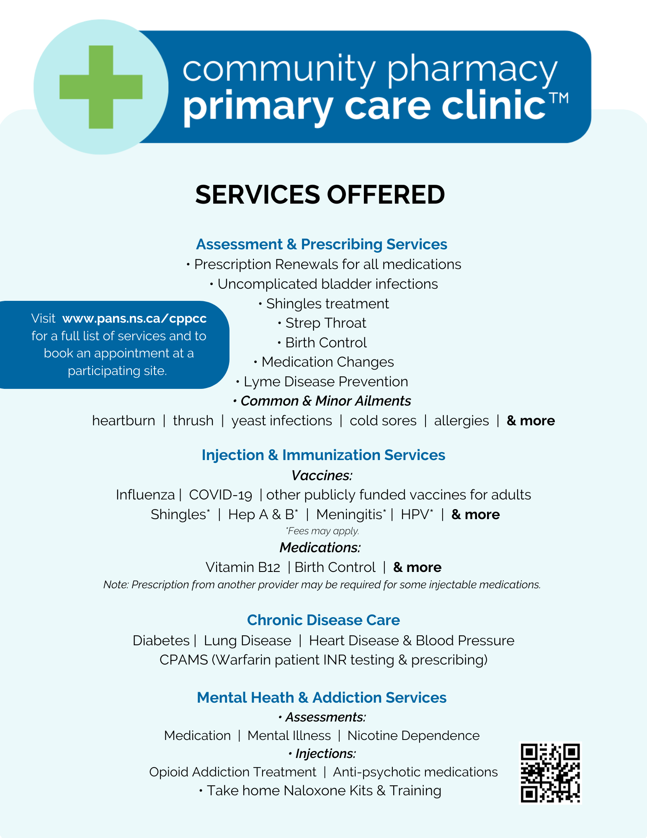

Slide 6
Pharmacist Scope of Practice
Medication Management (Basic medication review, advanced medication reviews (Pharmacare seniors), complex medication reviews available at pilot sites only (those patients being referred by another provider for a review, or un-attached patients with a need for a review)
Prescribing
Renewing, Adapting, substituting, deprescribing
New medication research for pilot sites only, which started as adding on therapy for those previously diagnosed with CVD, Asthma, COPD, Diabetes. In July 2024 this has been expanded to any previously diagnosed condition (excluding mental health)
Minor ailments + Prescribing by protocol (see other slide)
Strep assessment, testing and prescribing – originally approved as research for pilot sites only which has recently been expanded as within scope for all NS pharmacies who have completed training
Injection services
I/M medications (may need alternate site training if not in deltoid)
S/C
Vaccines – including publicly funded vaccines, non funded vaccines, high risk PFV to eligible patients. More details on PFV in another webinar session
Notes:
Note: prescribing new medications is approved as a research project only for diabetes, COPD, asthma, CVD
Bring list of minor ailments

Slide 7
Pharmacist Scope of Practice
Bloom, mental health and addiction services
Naloxone Training
Chronic Disease Management (CVD, DM, COPD, Asthma, Obesity, HTN, Non-cancer chronic pain, ADHD, other). This is a longitudinal service which starts with a longer initial assessment visit along with follow up visits through out the year (frequency depends of patient needs) to provide support/care for patients with diagnosed chronic diseases that need help managing their disease.
Pilot sites can diagnosis and prescribe for Hypertension and Type 2 Diabetes (those pharmacists who have undergone the training webinar with collaboration available with NPs)
Pilot sites can assess and prescribe for acute otitis media, acute otitis externa and acute bacterial rhinosinusitis (if training is completed)
Testing – Ordering and interpreting lab tests and conducting point of care tests (discussed in future slide)
Prescribe antimicrobial prophylaxis for close contacts identified by PH
Minor ailment assessment and prescribing

Slide 8
Ordering Laboratory Tests
Pharmacists can order lab tests as part of providing drug therapy management for a patient.
For example:
- If the patient needs a renewal, is having an advanced med review or chronic disease assessment monitoring or other tests have not recently been done, the pharmacist can order lab tests
Pharmacists cannot order tests to diagnose a patient
Ex. ‘I feel tired, I’m wondering if I have low B12’.
Refer to another provider
Ex. ‘I would like my B12 prescription renewed’
Pharmacist may need to order lab test

Slide 9
Vaccines
Publicly funded vaccines – covid-19 and flu, not promoted but if a phc decides to give in clinic, will need to be documented in CANImmunize- Internal calendar CPPCC internal
Vaccines covered by private drug plans or cash (Twinrix, Shingrix most common)
Pharmacist will need to prescribe these vaccines, then Rx filled/billed to plan, then injected.
Patients may wish to book virtual (or phone if not available) first for assessment, then booked in for injection
These are table 3 vaccines which you charge the patient for the administration fee
Other Publicly Funded Vaccines are available for eligible patients age 2+
No charge to patient for assessment/vaccine/administration
Grade 7 school vaccines NOT included
Other Routine Immunizations 2+ included
Some Patients eligible for high risk vaccines – HIV patients, immunosuppressive meds, “Other’ including chronic conditions
Many PFV are ordered via Shopify (watch order windows) and other high risk patient vaccines need to be approved (via fax case by case)

Slide 10
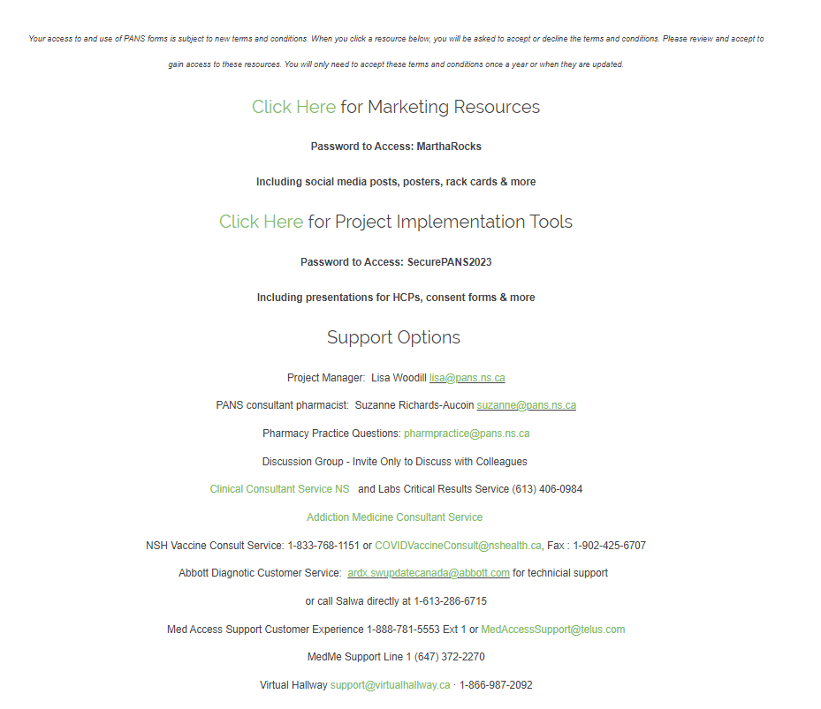
Project Resources: CPPCC website
Notes:
Project is not limited to those without a family physician, but is intended to help support this population. Pharmacists can also provide care within their scope, to reduce emergency room visits and free up appointment times at physician offices for appointments that are not within pharmacist scope (diagnostic/physical exams).

Slide 13
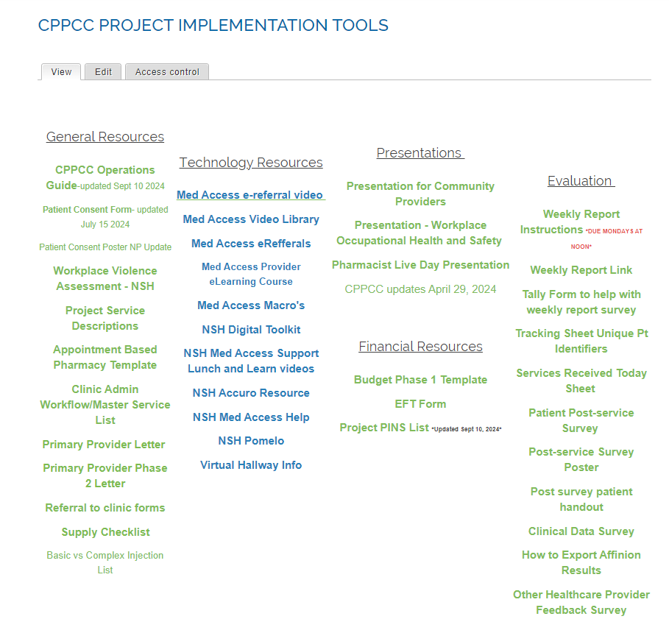

Slide 14
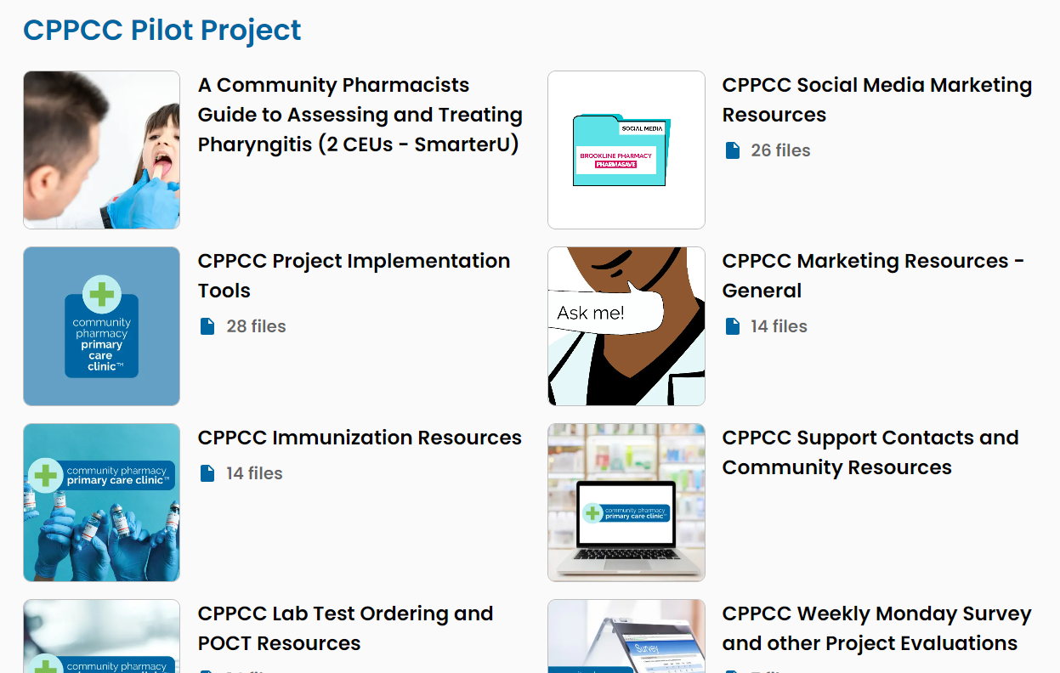
Resources: MemberLounge
https://pans.memberlounge.app/

Slide 15
Clinic Administrator Role
Bookings
Answer all clinic phone calls
Book the appointments that are made over the phone
Understand what type of appointment to book (different time value based on the type of apt)
Fully understand the billable appointment types so you can probe the patient
Create patient profiles of new patients (sometimes this includes in multiple systems ie: Kroll and Medaccess)

Slide 16
Clinic Administrator Role
Bookings
There will be specific screening questions for each service.
See cppcc website → implementation → Clinic admin workflow/master service list

Slide 17
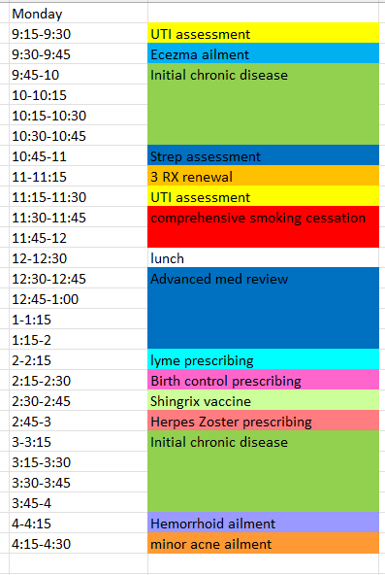
Booking
A typical day could
look like this:
Clinic Admin, will need to
Watch for intervals, contact
Patient that book longer
Services
Releasing Same day, next
Day appointments.

Slide 18
What to do when symptoms are out of pharmacist’s scope? → Is this something that the CPPCC-NP can consult on?
Unattached Patient
Referral to Virtual Care NS
Unattached patients that require assessment for an undiagnosed condition, but may not require in person visit (ex. depression, anxiety etc)
Unattached patients that may require specialist referral
Referral to Primary Care Clinics or Walk-in Clinics
Unattached patients that require assessment for an undiagnosed condition that will likely require physical assessment
Unattached patients that require annual or usual care physical assessment, tests ordered such as EKG etc. as part of chronic disease management
Attached Patient
Referral to Family Physician
Attached patients that require assessment for an undiagnosed condition (which can wait until next available appointment)
Attached patients that require specialist referral
Attached patients that require annual or usual care physical assessments, tests ordered such as EKG etc., as part of chronic disease management
If non-urgent but appointments not available at options above, refer to walk-clinics or other community resources. If urgent refer to Emergency Room

Slide 19
Clinic Administrator Role
Check-in
Greet patients and put them in private room when it is time for the appointment (ensure jackets off, ready to go when pharmacist comes in)
Sign Consent (if first time), document, scan, shred.
Patient intake forms
Confirm patient file up to date (contact info, allergies, med conditions) and EMR for CDM, Advanced Med Reviews
Confirm name of family physician/ unattached – document
If patient arriving for a vaccine, ensure CANImm consent forms are complete and if not complete with the patient (greeter function)

Slide 20
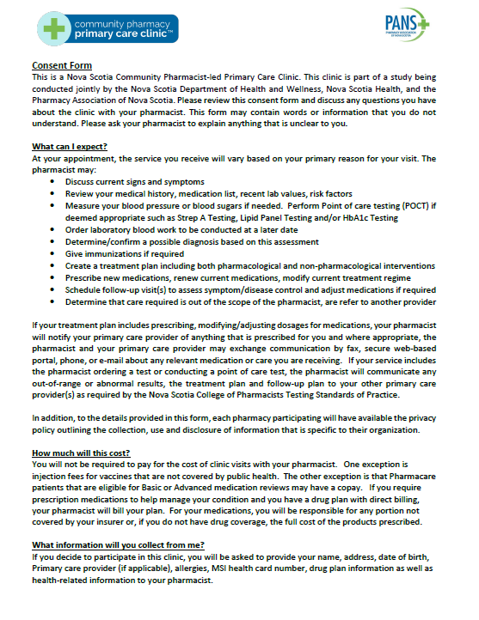
Patient Consent
Before entering the clinic for the first time, the patient will be presented a patient consent for to read and sign. It will explain the nature of this project, that it is part of a study being conducted jointly by the Nova Scotia Department of Health and Wellness, Nova Scotia Health, and the Pharmacy Association of Nova Scotia. The consent form outlines what the patient can expect, costs associated, the personal information that will be collected, how that information will be used, along with what measures the clinic/project will do to keep personal health information private.
If a virtual or phone appt is booked for first time, contact pt in advance, confirm chief reason for appointment, review consent details, document verbal consent on pt profile, consistent place
Future bookings need to confirm this is documented.

Slide 21
Post visit - clinic admin duties
Fax communication to provider (if necessary)
Bill for the service as per pharmacist (services received sheet)
Post service clinical portal survey (services received sheet)
Book patient in for follow up if needed

Slide 22
Clinic Admin: Post Appointment
Communication the results
Post appointment FAX (if necessary). May look like the image on the left or may be a consultation summary form
As per NSCP Standards for Prescribing and Testing, pharmacists are required to notify a patient’s family physician/NP of all test results and prescribing. During this project, this requirement will be satisfied by sending a fax communication

Slide 23
Saving Files – Be Mindful of the Name
Sortable by date (clinical, audit purposes)
Filterable by the clinic (CPPCC), service type (minor ailment, injection) service (Bloom, CVD management, CPAMS), setting (In-Person, Virtual), document type (Labs, Referral)
Examples:
2022 12 08 CPPCC Labs SHARE TSH
2022 12 09 CPPCC Bloom Initial Assessment IP
2023 01 02 CPPCC Bloom Follow-Up Virtual
2023 01 10 CPPCC Prescribing UTI Phone
2023 01 10 CPPCC Drug Admin Shingrix IP
2023 01 10 CPPCC Labs eGFR, K+

Slide 24
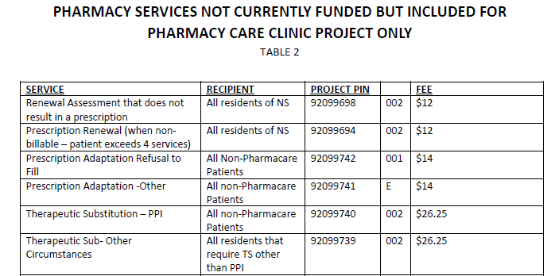
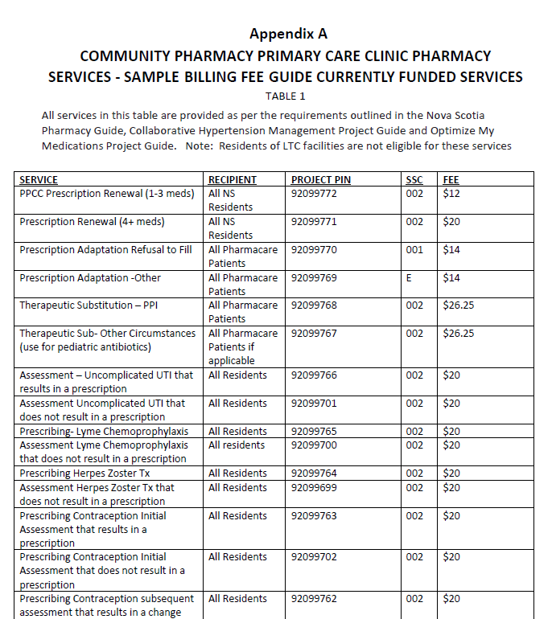
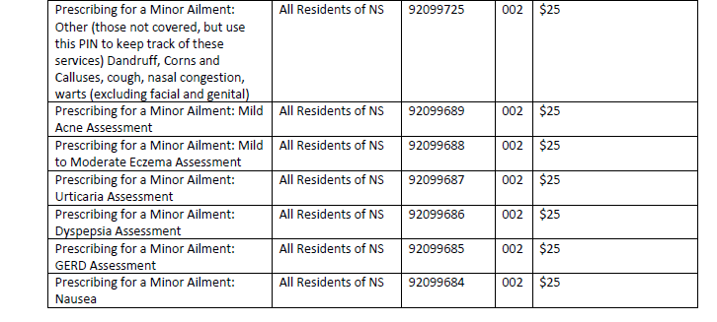
Billing
Billing the service: PIN list

Slide 25
Data Collection per month
Monthly Survey – 1st day of each month
https://24.selectsurvey.net/researchpowerinc/CPPCC_clinic_report

Slide 26
Weekly survey – Moving to Monthly survey tool. Please complete the last weekly survey on Friday for the dates October 27th to October 31st (Sunday to Thursday).
Bi-weekly report upload – moving to monthly report upload. We no longer require one report for all and one for unattached. Once a month, please follow the same process for all CPPCC patients and upload one report to the shared folders. Please upload your final report up to October 31st. The next upload will be on December 1st for the period of November 1 to 30th.
Starting Friday, November 1st, save the document ‘Monthly Survey per Day’ to your clinic desktop. The clinic admin should complete the chart at the end of each day. On December 1st, the totals from the chart should be added to the monthly survey. The excel spreadsheet will auto-calculate the totals as you go.
Starting November 1st, a new simplified Services Received Today sheet can be used. Some pharmacies use this to communicate between pharmacist and admin what to bill so we have left the first page to be used for that purpose. Page 2 is used to track the content that must continue to be added to the Clinical services Data portal tool. The NSCP research will continue until December 31st and we need to continue to track data on NP program and referrals/collaboration with other providers as to continue to develop these important pathways. We also want to continue to know any services that you are providing that are not currently billable.
Patient surveys do not need to be collected during this interim period.

Slide 27
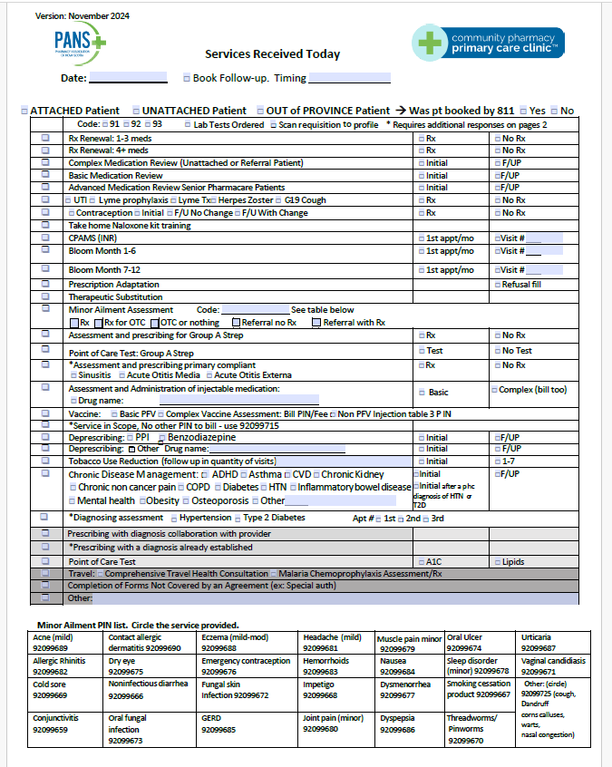
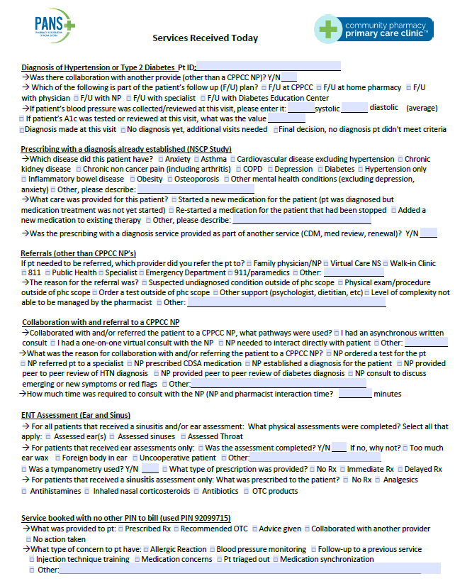
Data Collection per visit
https://24.selectsurvey.net/researchpowerinc/CPPCC_pt_care

Slide 28
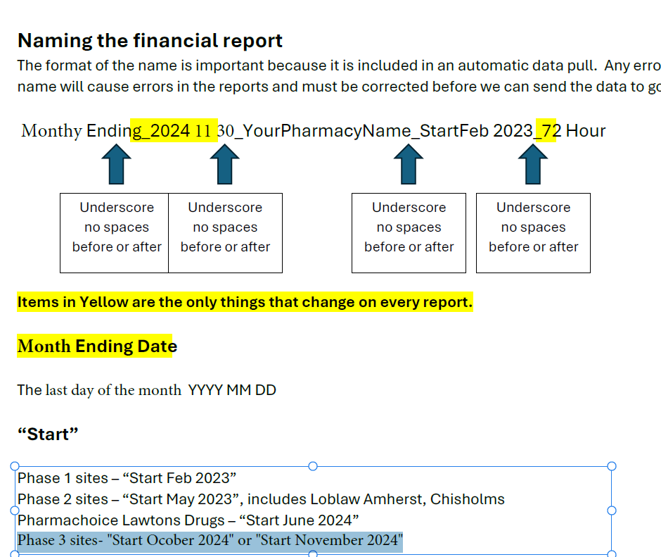
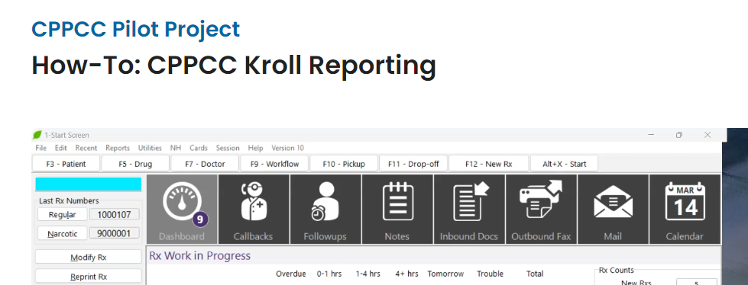
Data Collection: Financial Reports
This will be submitted every month starting December 1st
Discusswith clinic lead/manager/owner
who will be doing this task
SDM is completed by head office.
Uploaded to a shared file
See video in Memberlounge on how to:

Slide 29
Clinic Admin: Other duties
Other
Clean rooms in between uses, ensure supplies required in the room are stocked (POCT, injection supplies, brochures, etc)
Maintain vaccine inventory – monitoring cold chain, place orders when inventory low
During down times, call patients that may have missed appointments to rebook, run reports to identify patients that may benefit from services such as CPAMS, Medication reviews, vaccinations, Chronic disease management etc. Discuss plan with pharmacist and assist with contacting patients to let them know about services
Ensure patients receive rack card list of services and info about how to book

Slide 30
Clinic Admin Check list
How to use your sites booking system
How to enter new patient profiles
Understand what services are being offered and the criteria needed to be eligible for the service
How to use/assess/navigate the CPPCC website
Understand who will be ordering PFV via shopify and have a copy of order windows easily accessible
Know how service completed information will be given to you: Serviced received paper? EMR saved file?
Be able to log into CANImm and book appointments
Be confident in billing the PIN for service provided

Slide 31
Clinic Admin Documents to Review
Services Received sheet
Operations Guide
PIN list (table 1, 2, 3)
Daily tally for monthly survey report saved to desktop
Have a copy of Injection criteria for complex assessment (med injection & PFV) printed/saved
Quick access to link for CPPCC webpage
Excel clinic master service list eligibility criteria to help triage out patients
Have patient consent forms ready
Print out viral RX for patients

Slide 32
Prescribing Standards and Billing
Frequently Asked Questions

Slide 33
Common Prescribing Standards Questions
Renewals
The standards no longer indicate a specific duration. Pharmacist discretion.
Billing – required to renew as per previous durations unless there is a clinical reason to change duration. Pharmacist must document reason to renew different duration.
Think- is there a reason another provider would not renew for 90 days by 3 refills
CAN do an adaptation or therapeutic sub at the time of renewal
CAN renew CDSA Medications with part fills if indicated. Cannot renew acute pain medications and some exceptions for OAMT.
CAN prescribe without bloodwork, but may wish to prescribe shorter duration and then re-assess
Follow-up plan CAN include determining when it is appropriate to provide pt advice on when to follow-up
Therapeutic Substitutions
Can substitute to a different class of medication
For participants in the CPPCC project only – CAN also add medications for diabetes, asthma, COPD, and cardiovascular disease (research project approved by NSCP)

Slide 34
Common Prescribing Standards Questions
Minor Ailments
CAN prescribe any medication appropriate for any of the conditions on the the ailment list if pharmacists confirms they have the condition.
Prescribing by Protocol
Herpes Zoster (Shingles disease) – need to start treatment ASAP so used reserved appointments. If eye/ear involved, they will also need to go to emergency.
COVID-19
CAN prescribe budesonide as per protocol for covid-19 cough but would need a positive test
Lyme Disease
CAN prescribe without seeing tick if confident it was a black legged tick. Standards say must be competent to identify the tick.
CAN prescribe if patient has bull’s eye rash- this is early lyme dx
CANNOT prescribe if patient has long term or later symptoms/complications

Slide 35
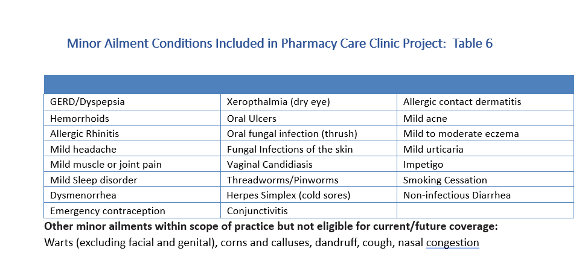

Slide 36
What Do I Bill for CPPCC?
Patient comes in for a CDM, Med Review or Bloom Service and requires a renewal of medications
Bill the primary service the patient received
If the information required for a renewal was part of the service, cannot double bill.
If it is for a different medication (ex. CDM diabetes consult and needs Synthroid renewed, bill the renewal assessment as well
Patient comes in for a service (ex. Med Review, renewal, CDM) and the pharmacist exercises project scope to prescribe a new additional medication for diabetes, COPD, asthma or CVD
Bill the primary service the patient received
Also bill the PIN for Prescribing with a diagnoses confirmed by pharmacist and change the fee to $0 ($0 if the assessment was completed as part of primary service)

Slide 37
What Do I Bill for CPPCC?
Patient is on CPAMS and requires a renewal on their warfarin prescription
Complete a renewal assessment and bill the renewal PIN (up to once per year)
Continue to see patient for POCT, and assessments at interval recommended at most recent appointment
A patient books an appointment for a renewal and it is apparent that a number of medication therapy problems are present.
Bill the renewal Pin if able to collect adequate information to complete the renewal for a limited duration
Book the patient to come back for the appropriate service (CDM, Med Review if Pharmacare, or Complex Medication Assessment

Slide 38
Pharmacy Dispensary Service vs CPPCC
If a patient presents after clinic hours but dispensary is open and requires a renewal, adaptation, therapeutic sub or other serviced that cannot wait until an appointment is available at the clinic, the pharmacy should proceed with offering the service and bill using the usual PINS. DO NOT USE CPPCC PINS
If a patient presents after hours and requires a service which can reasonably wait for the next available appointment time, the dispensary staff should book them into the clinic

Slide 39
Managing Patient Expectations or Concerns
If the patient expresses a concern to either PANS, the pharmacist or the physician/NP, the health care practitioner will:
Address any immediate health care needs of the patient
If an error has occurred, follow any procedures as required by your licensing body and your organization. NSCP now has a required reporting tool called Clinical Incident Reporting Tool Qualtrics Survey | Qualtrics Experience Management
Document the conversation
Be transparent with the patient regarding your intent to have a discussion with all health care professionals that are collaborating on this patient’s care
Involve the patient in the process of finding solutions to problems and implementing systems to prevent similar concerns again in the future
If the concern involves project expectations or research concerns, contact PANS Director of Pharmacy Practice.
When appropriate implement changes that will provide errors/concern from occurring again
Seek guidance before responding on social media

Slide 40
Project Support Team
Allison Bodnar abodnar@pans.ns.ca
Lisa Woodill lisa@pans.ns.ca
Glen Rodrigues glenn@pans.ns.ca
Suzanne Richards-AuCoin suzanne@pans.ns.ca

Slide 41
Questions?

