Slide 1
Information for Community Providers
Last updated Sept, 2024

Slide 2
Agenda
Project overview
Background – why is this needed
Services Offered
Pharmacist Scope of Practice
Clinic patients
Clinical resources
Communication of Results
Pharmacy Referrals – out of scope services
Point of care testing
Quality assurance
Data collection

Slide 3
Project Overview
The Community Pharmacy Primary Care Clinic (CPPCC) Demonstration Project was launched on February 1st, 2022. The project began with 12 clinic sites which expanded to include an additional 13 sites as of November, 2023, 6 Lawtons PWIC+ sites joined the project June, 2024 and we have just announced an additional 15 sites will be added September/October 2024 for a total of 46 sites across Nova Scotia.
Pharmacies are providing appointment-based (same day/next day) services for all primary care services that are within the pharmacist scope of practice.
A pharmacy clinic admin assistant was hired/re-deployed to support clinic activities as well as project documentation, ensuring the pharmacist is maximizing patient appointment time.
Based on demand in the geographical area and available staff, some clinic have been approved to provide care 20, 40 up to 60 hours a week which includes a mixture of days, nights and weekend hours.

Slide 4
Project Overview
This is a demonstration project funded by the Department of Health and Wellness, Pharmacy Service Agreement, Tariff Funding
The project is supported by a working group with representatives from Department of Health and Wellness, Nova Scotia Health, Pharmacy Association of Nova Scotia, Doctors Nova Scotia and community pharmacists.
The goals of the study will be to evaluate:
Patient Access and Satisfaction with Care
New appointment based pharmacy workflow models- impact to the pharmacy team
Impact of the clinics on the healthcare system (ER, community providers and stakeholders). We will be looking for community providers that are willing to have an interview (September, 2023 and October, 2024)

Slide 5
Background
Notes:
Project is not limited to those without a family physician, but is intended to help support this population. Pharmacists can also provide care within their scope, to reduce emergency room visits and free up appointment times at physician offices for appointments that are not within pharmacist scope (diagnostic/physical exams).

Slide 6
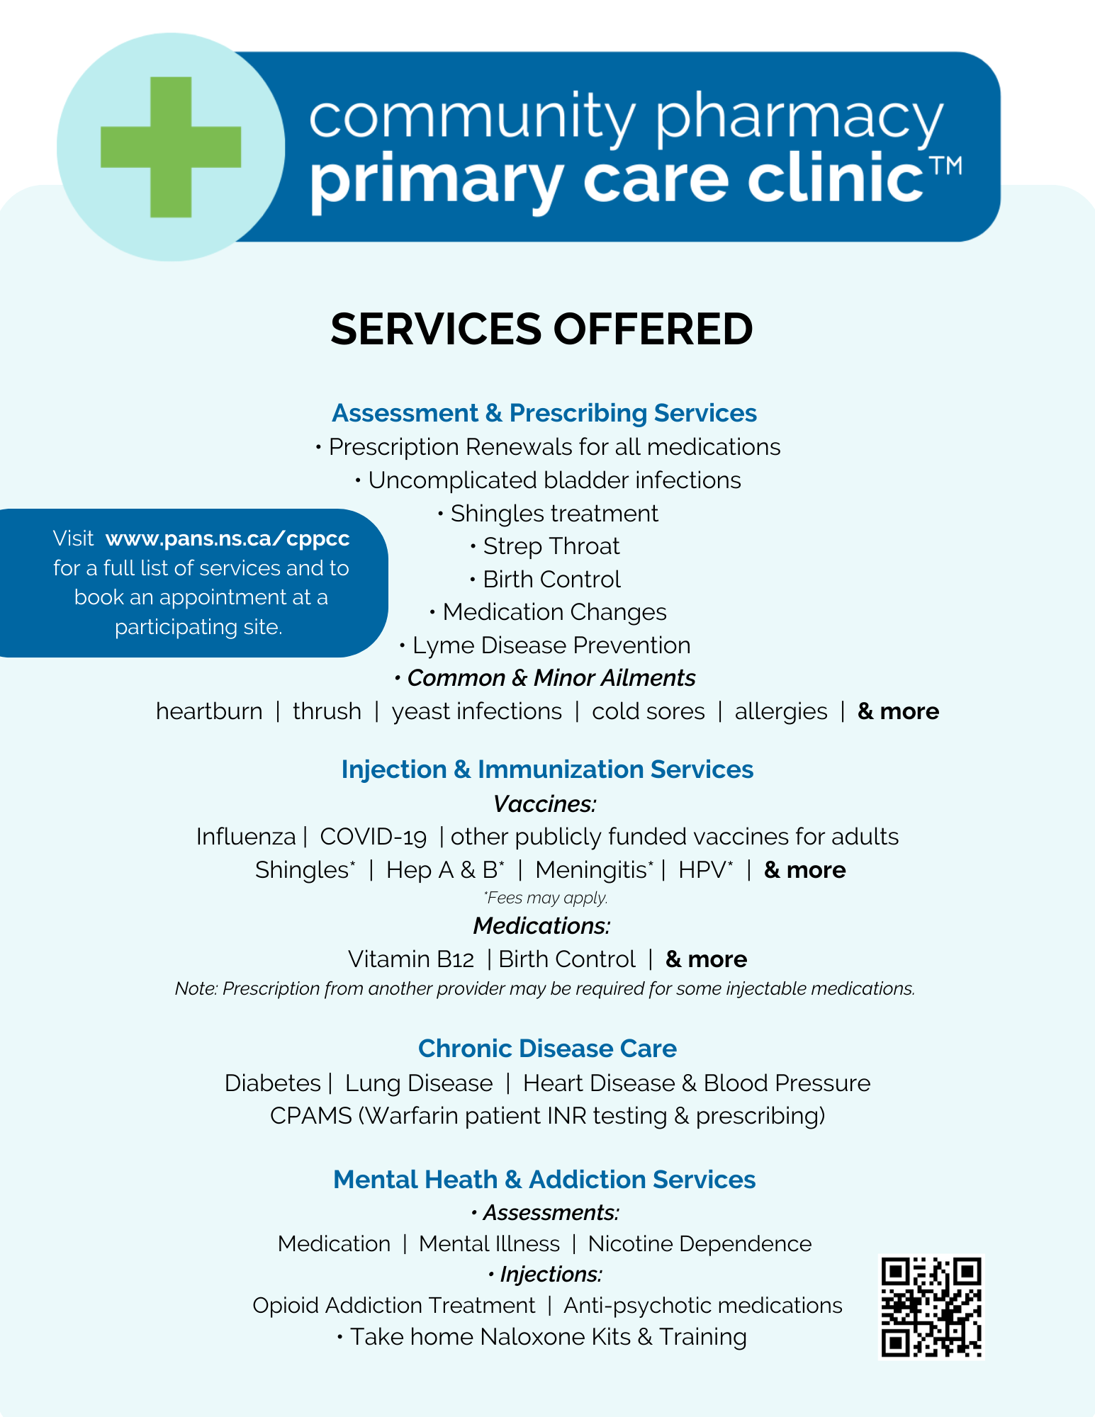
Notes:
These are the services offered. Chronic disease care includes a review of all medications for the condition. Pharmacists can adapt, substitute, start new medications, taper or discontinue. It also includes review of non-pharm or lifestyle factors that support patient meeting goals, use of devices (BP, glucose) to monitor their condition and/or POCT A1C and lipids if the patient is due.

Slide 7
Pharmacist Scope of Practice
Medication Management (Basic medication review, advanced medication reviews (Pharmacare seniors), complex medication reviews available at pilot sites only (those patients being referred by another provider for a review, or un-attached patients with a need for a review)
Prescribing
Renewing, Adapting, substituting, deprescribing
New medication research for pilot sites only, which started as adding on therapy for those previously diagnosed with CVD, Asthma, COPD, Diabetes. In July 2024 this has been expanded to any previously diagnosed condition (excluding mental health)
Minor ailments + Prescribing by protocol (see other slide)
Strep assessment, testing and prescribing – originally approved as research for pilot sites only which has recently been expanded as within scope for all NS pharmacies who have completed training
Injection services
I/M medications (may need alternate site training if not in deltoid)
S/C
Vaccines – including publicly funded vaccines, non funded vaccines, high risk PFV to eligible patients
Notes:
Note: prescribing new medications is approved as a research project only for diabetes, COPD, asthma, CVD
Bring list of minor ailments

Slide 8
Pharmacist Scope of Practice
Bloom, mental health and addiction services
Naloxone Training
Chronic Disease Management (CVD, DM, COPD, Asthma, Obesity, HTN, Non-cancer chronic pain, ADHD, other). This is a longitudinal service which starts with a longer initial assessment visit along with follow up visits through out the year (frequency depends of patient needs) to provide support/care for patients with diagnosed chronic diseases that need help managing their disease.
Pilot sites can diagnosis and prescribe for Hypertension and Type 2 Diabetes (those pharmacists who have undergone the training webinar with collaboration available with NPs)
Pilot sites can assess and prescribe for acute otitis media, acute otitis externa and acute bacterial rhinosinusitis (if they completed training)
Testing – Ordering and interpreting lab tests and conducting point of care tests (discussed in future slide)
Prescribe antimicrobial prophylaxis for close contacts identified by PH

Slide 9
Minor Ailments
GASTROINTESTINAL
Diarrhea (non-infectious)
GERD
Hemorrhoids
Nausea
INFECTIONS
Uncomplicated UTI Infections
Herpes Zoster
Strep Throat
Vaginal yeast infections
Fungal infections of the skin
Impetigo
Cold Sores
Lyme disease prevention and Early Lyme Treatment after black legged tick bite
Notes:
For each of the conditions, pharmacists have algorithms to screen for red flags and will refer if there is a concern of another condition that required diagnosis/investigation and if they feel a physical exam is required that is outside of scope.

Slide 10
Minor Ailments Continued
HEAD/ NOSE/ THROAT
Allergic Rhinitis
Cough
Covid 19 cough (budesonide prescribing)
Headache (mild)
Nasal Congestion
Oral Thrush
Oral Ulcers
Sore Throat
REPRODUCTIVE HEALTH
Hormonal birth control (female reproductive system)
Dysmenorrhea (menstrual cramps)
Emergency Contraception
Vaginal Yeast Infections

Slide 11
Minor Ailments Continued
SKIN CONDITIONS
Acne (mild)
Calluses and Corns
Contact Allergic Dermatitis
Dandruff
Eczema (mild to moderate)
Fungal Infections of the Skin
Hives (mild)
Impetigo
Warts (excluding facial and genital)
OTHER
Dry Eye
Conjunctivitis
Joint Pain (minor)
Muscle Pain (minor)
Sleep Disorders (minor)
Smoking Cessation
Threadworms and Pinworms

Slide 12
Ordering Laboratory Tests
Pharmacists ordering lab tests was enabled by scope of practice in 2013, however they are just starting to be added as providers to the NSH Lab System
Pharmacists in this pilot are the first group of pharmacists with this access.
Pharmacists can order tests that are recommended for initiation or monitoring of drug therapy. Pharmacists will receive results via fax and/or EMR.
Results will be in SHARE for other providers to access.
Family physician/NPs are notified when results are out of range and any prescribing actions taken by the pharmacist
All critical values are reported to the Pharmacist Clinical Consult team to be discussed with the pharmacist (during clinic hours) or directly with the patient (if after hours)

Slide 13
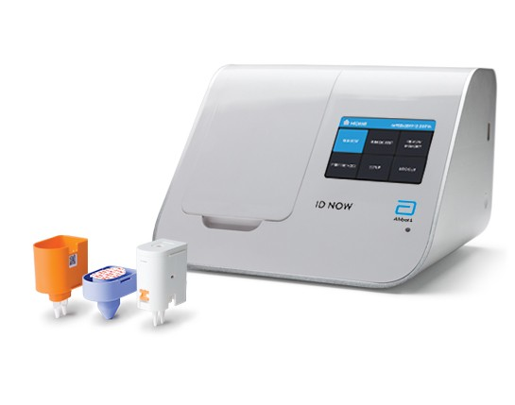
Point of Care Testing
Afinion HbA1c
Afinion Lipid Panel
ID NOW Group A Strep
Coaguchek Pro II

Slide 14
Patient Information
Who can book?
This project will allow patients of the pharmacy along with non-patients to book appointments with the clinic. There is no charge for assessments for patients with a NS Healthcard.
Community providers such as the Emergency room, walk-in clinics, diabetes clinics, primary care clinics physician or NP offices can request signage/handouts/business cards that include types of services and info on how to refer patients to book.
Booking appointments
People who have ailments/conditions that fit the criteria can book an appointment through the online booking portal, or they can call the pharmacy directly to schedule an appointment. There will be time set a side each day for “same day” visits on conditions that are time sensitive.
Patient Consent
Before entering the clinic for the first time, the patient will be presented a patient consent for to read and sign. It will explain the nature of this project, that it is part of a study being conducted jointly by the Nova Scotia Department of Health and Wellness, Nova Scotia Health, and the Pharmacy Association of Nova Scotia. The consent form outlines what the patient can expect, costs associated, the personal information that will be collected, how that information will be used, along with what measures the clinic/project will do to keep personal health information private.

Slide 15
Who can CPPCC pharmacists consult with regarding patients?
Clinical Consultant Service of NS
Addiction Medicine Consultant Service
NSH Vaccine Consult Service
As of July 2024, NSH has partnered with PANS to provide 3 Nurse Practitioners designated to work with CPPCC pharmacists (Virtual Care Platform used by most clinics). The list of areas to consult keeps expanding, but currently for services such as: CDM cardiovascular disease, HTN, COPD, Asthma, kidney disease, thyroid disorder, dyslipidemia

Slide 16
What to do when symptoms are out of pharmacist’s scope?
→ If within list of consultable services, phc can discuss with CPPCC-NP who can diagnosis/refer/give advice
Patients with a Family Physician
Referral to Family Physician
Attached patients that require assessment for an undiagnosed condition (which can wait until next available appointment)
Attached patients that require specialist referral
Attached patients that require annual or usual care physical assessments, tests ordered such as EKG etc., as part of chronic disease management
Referral to Walk-in Clinics
If patient requires non-urgent care and is unable to obtain an appointment with family physician in recommended time frame will be referred to walk-in (ex. requires physical assessment for otitis media)
If Urgent Referral to Emergency Room (ER)
Any patient (attached or unattached) that requires urgent medical treatment
Patients without a Family Physician
Referral to Virtual Care NS
Unattached patients that require assessment for an undiagnosed condition, but may not require in person visit (ex. depression, anxiety etc)
Unattached patients that may require specialist referral
Referral to Primary Care Clinics or Walk-in Clinics
Unattached patients that require assessment for an undiagnosed condition that will likely require physical assessment
Unattached patients that require annual or usual care physical assessment, tests ordered such as EKG etc. as part of chronic disease management
If Urgent Referral to Emergency Room (ER)
Any patient (attached or unattached) that requires urgent medical treatment

Slide 17
Communicating Results
As per NSCP Standards for Prescribing and Testing, pharmacists are required to notify a patient’s family physician/NP of all test results and prescribing. During this project, this requirement will be satisfied by sending a fax communication

Slide 18
Interested in referring a patient?

Slide 19
Questions?

