Slide 1
Publicly Funded Vaccines at the Community Pharmacy Primary Care Clinic

Slide 2
Agenda
Lisa Woodill
Program Overview
Communications
Booking
CanImmunize Updates
Preparation
Allocations
Resources
Workflow
Evaluation
Available training

Slide 3
Publicly Funded Vaccine Program
The CPPCC participating pharmacies will have access to order, administer and bill for publicly funded vaccinations for children aged 2 and up. Exceptions:
Influenza and covid-19 vaccinations age 6 months and up by pharmacists or pharmacy technicians with additional training to provide to this age group
Patients eligible for grade 7 school-based program are not eligible to have PFV at a pharmacy and will be referred to public health
Residents (with a valid NS Healthcard) are eligible. Exceptions: covid-19 vaccine and influenza
Pharmacists will have access to a Vaccine Consult Service via NSH Infectious Disease. This team supports all publicly funded vaccinations
Vaccinations provided will be documented in CANimmunize and will feed to Panorama. The pharmacy will be paid $18 per vaccine entered as administered in CANImmunize.
Booking will be done by the pharmacy upon request of an eligible patient, referral from other providers or public health or identification of vaccination need by pharmacist as part of providing other services.

Slide 4
Publicly Funded Vaccine Program
Will include vaccines that are part of routine immunizations (for patients aged 2 and up)
Will include vaccinations for patients at high-risk that are eligible for publicly funded supply. These vaccines are often ordered on a per patient basis by sending a fax order form to your local public health office. Fax order forms can be found at: https://physicians.nshealth.ca/resources/immunization-forms-providers
Pharmacist will also continue to recommend, prescribe and/or administer vaccines that are not currently publicly funded such as herpes zoster vaccination, travel vaccines etc.

Slide 5
Publicly Funded Vaccines – Communications
The program originally started as a soft launch but over the past year it has been increasingly popular.
How do people hear about it?
We have shared with other pharmacists via PANS member newsletter
We have shared with other stakeholders and providers
Health Protection Branch, Primary Care Clinic Leads, Virtual Care, 811 have been notified
If you are a new clinic in your area, it may be a good idea to reach out to local providers (physicians and nurse practitioners) and local public health office to let them know you are participating in this pilot project and which vaccines you have in stock along which ones can be ordered if needed.

Slide 6
Publicly Funded Vaccines – Booking
Many sites have Vaccine as a booking option on their online booking platform. We recommend a telephone/virtual consult booking first or Call to book.
Patients may be identified in the dispensary and come to the clinic inquiring about the service.
Patients may be identified as part of other services being provided at the clinic such as chronic disease management or medication renewal assessment. If you have all the info needed to proceed, a new ‘drop-in’ feature in CANImmunize can be used. If a vaccine history or more time is required, the patient can be booked in for a follow-up appointment.
If a patient is booked to come back at a later date, you can use the internal calendar to have them booked into CANImmunize in advance but will also need to reserve a spot in your clinic calendar so you are not double booked. Alternatively, book them in your clinic calendar and use the drop-in when they arrive.
Vaccine assessments can also be done virtually with an appointment time booked to come in for the injection on a different date.

Slide 7
Non-Publicly Funded Vaccines
Some patients will require a combination of publicly funded and non-publicly funded vaccines. (or only non-publicly funded vaccines).
Non-publicly funded vaccines will continue to be documented in the pharmacy management software system, billed to their third party if applicable and sent to DIS. DIS now feeds to panorama.
Injection fees for non-publicly funded vaccines are not included in project (table 3) and will continue to need to be charged to the patient directly.
Virtual appointments are helpful for vaccination assessments as prescriptions can be written, billed to third party plans and ready to go for the non-publicly funded vaccines in advance of the patient arriving for the appointment. If this is applicable, each pharmacy should have a process in place, such as asking the patient to pick-up their vaccine at the pharmacy pick-up area, before proceeding to the clinic.

Slide 8
Publicly Funded Vaccines – CANImmunize
Patients can be booked into the internal calendar
A drop-in feature is also available which can be done directly from the App during the appointment or clinic admin can be set up as a ‘greeter’ in CANimmunize to complete consent prior to pharmacist administering.
There will be one vaccine screening and consent form for influenza and publicly funded vaccines. Covid-19 is the exception and will still require a separate form.
There is nothing to prevent non-residents from having other vaccines entered into CANimmunize at this time. They will not be paid. Please ensure you are asking all patients for NS Healthcard at appointment booking and when entering drop-ins.

Slide 10
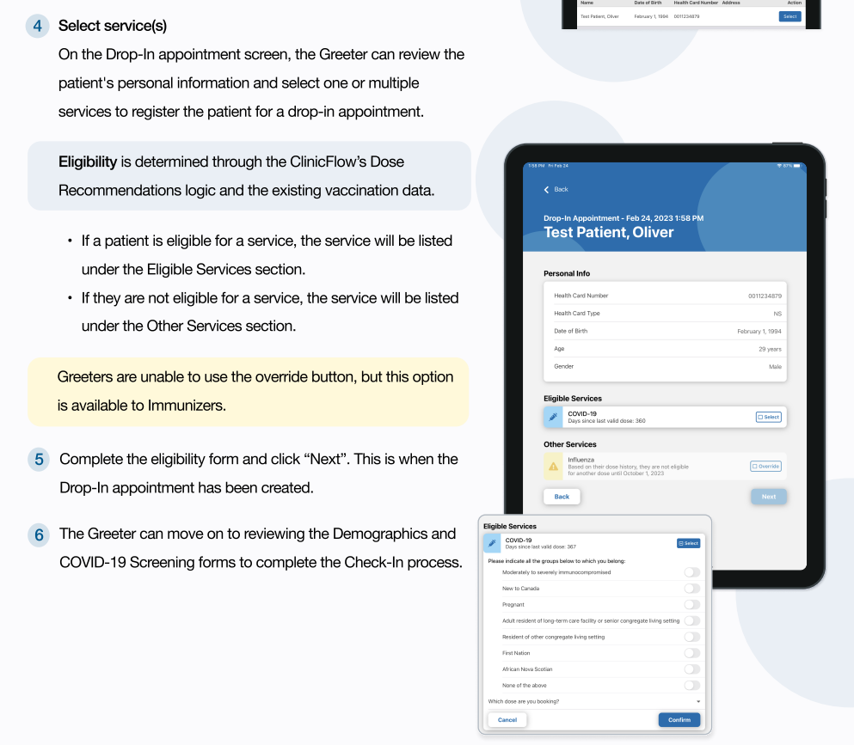

Slide 11
Immunizer Additional Features

Slide 12
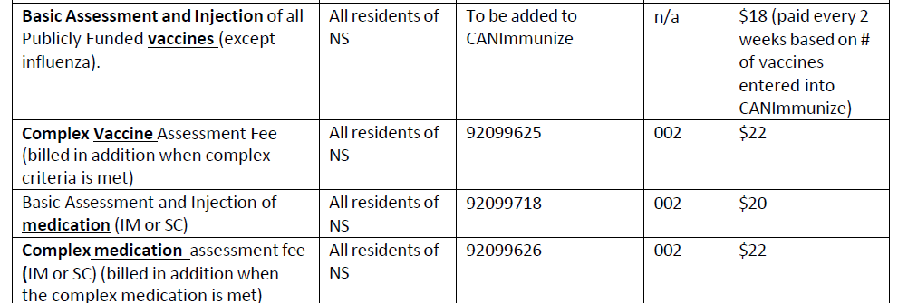
Publicly Funded Vaccines – Billing
PFV are billed through CANImmu
Extra PFV complex vaccine assessment PIN (criteria found cppcc website → implementation → medication injection basic vs complex document

Slide 13
Publicly Funded Vaccines – Preparation
Pharmacists should ensure they are up to date by completing the PANS Immunization Course if they have not already
Clinic Admins should be set up as a greeter and trained on how to use the new drop-in feature in CANImmunize
Ensure you have enough room in your fridge.
Review cold chain procedures with your clinic admin staff
Review plans for power outages with entire pharmacy team and ensure you have back-up generators, alarms and a plan in place to transport the vaccine to another vaccine fridge (pharmacy, public health) when required.
Order windows are available on CPPCC vaccine page along with ML and clinic staff should have these posted somewhere in the clinic

Slide 14
Publicly Funded Vaccines – Allocation
By now, an initial allocation should be available for you to order in shopify.
The Biodepot now releases allocations per quarter with the third quarter being Oct-Dec and fourth quarter will be Jan-March 2025.
We have started all sites with:
Td 20, Tdap 20, P-20 #10, P-15 #10
MMRII #20, Varicella 10,
DTap-IPV-Hib #10, Tdap-IPV #20, Men C #20, Polio #2
Many high risk patient vaccines are special order(via fax) on
a per patient basis (examples: Mpox, Hep A, Hep B, HPV)
Please order the quantity that you feel will be used, not necessarily the full allocation
If you require more allocation before the next quarter begins, please email Suzanne or Lisa and we will put in a request for you (please let us know which vaccine and desired quantity)

Slide 15
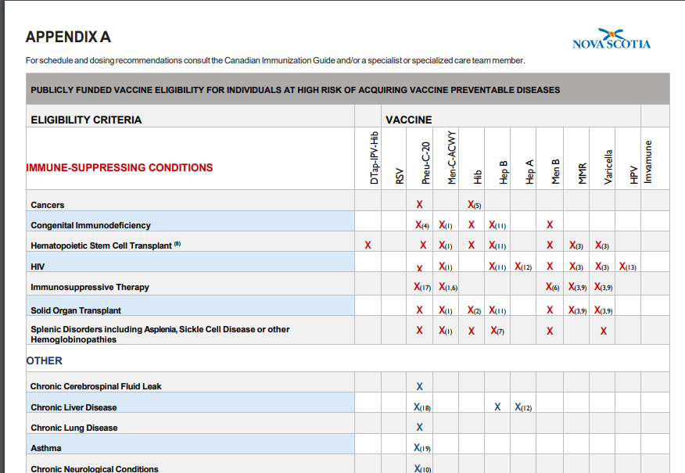
Publicly Funded Vaccines – High risk eligibility

Slide 16
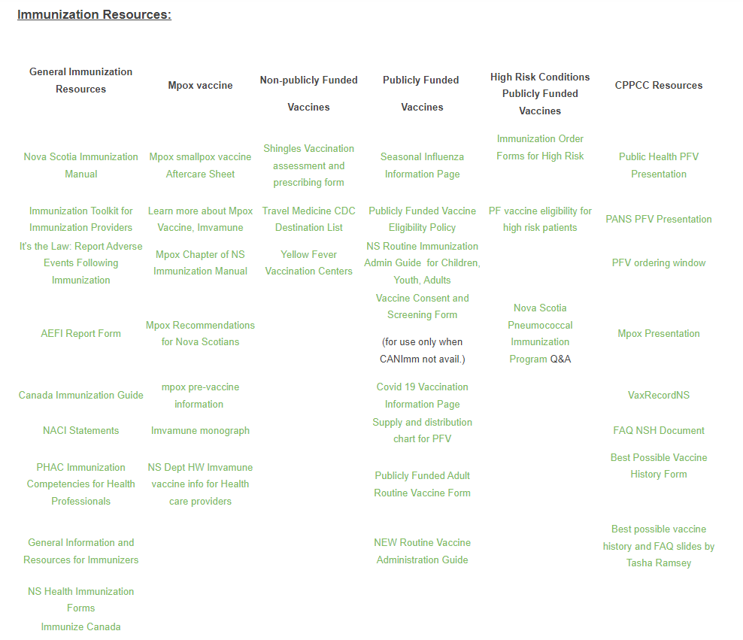
Publicly Funded Vaccines – Resources CPPCC website

Slide 17
Publicly Funded Vaccines – Workflow
As mentioned previously, consider virtual assessments in advance of appointment
Patient receipts will be available in CANimmunize
Book patients in for next dose in a series before leaving (when 1-2 months away).
If next dose is in 6 months time, set a reminder note in your pharmacy software system to call and book at that time, if you have this option available.

Slide 18
Publicly Funded Vaccines – Billing

Slide 19
PFV Training
This webinar with: Lisa Woodill, BSc. Pharm, Director of Pharmacy Practice, PANS
Smarteru Adult Immunization Course
Public Health PFV Presentation (on cppcc vaccine page)
Mpox Presentation (cppcc vaccine page)
Best possible vaccine history and FAQ slides by Tasha Ramsey (cppcc vaccine page)
2024 Fall Update Webinar: Influenza and Pneumococcal Vaccines for Pharmacy Professionals by Tasha Ramsey (smarteru)

Slide 20
QUESTIONS?

