Slide 1
CPPCC Project Launch Training October 2024

Slide 2
Agenda
Project overview
Background
CPPCC resources
Services Offered
Pharmacist Scope of Practice
Clinic patients
Clinical resources
Communication of Results
Pharmacy Referrals – out of scope services
Clinic Admin Role
Data collection
FAQ: What do I bill
Site Visits

Slide 3
Project Overview
The Community Pharmacy Primary Care Clinic (CPPCC) Demonstration Project was launched on February 1st, 2022. The project began with 12 clinic sites which expanded to include an additional 13 sites as of November, 2023, 6 Lawtons PWIC+ sites joined the project June, 2024 and NS Government just announced an additional 14 sites will be added September/October 2024 for a total of 45 sites across Nova Scotia.
Pharmacies are providing appointment-based services for all primary care services that are within the pharmacist scope of practice. This includes same day/next day appointments at all sites and released the day before/morning of for acute conditions.
A pharmacy clinic admin assistant is hired/re-deployed to support clinic activities, ensuring the pharmacist is maximizing patient appointment time.
Based on demand in the geographical area and available staff, some clinic have been approved to provide care 20, 40 or up to 60 hours a week which includes a mixture of days, nights and weekend hours.

Slide 4
Project Overview
This is a demonstration project funded by the Department of Health and Wellness, Pharmacy Service Agreement, Tariff Funding
The project is supported by a working group with representatives from Department of Health and Wellness, Nova Scotia Health, Pharmacy Association of Nova Scotia, Doctors Nova Scotia and community pharmacists.
We expect the data collection for the majority of the study to end October 31, 2024, therefore Phase 3 will not participate in the overall data, only for ongoing research projects we will discuss later. The goals of the study were to evaluate:
Patient Access and Satisfaction with Care
New appointment based pharmacy workflow models- impact to the pharmacy team
Impact of the clinics on the healthcare system (ER, community providers and stakeholders).
Understand compensation models that are sustainable for pharmacies.

Slide 5
Background
Notes:
Project is not limited to those without a family physician, but is intended to help support this population. Pharmacists can also provide care within their scope, to reduce emergency room visits and free up appointment times at physician offices for appointments that are not within pharmacist scope (diagnostic/physical exams).

Slide 6
Resources
CPPCC Clinic Page (show page)
Contacts
Clinical tools
Marketing Resources
Implementation Tools
Member Lounge
(show page)

Slide 7
Education

Slide 8
Education

Slide 9
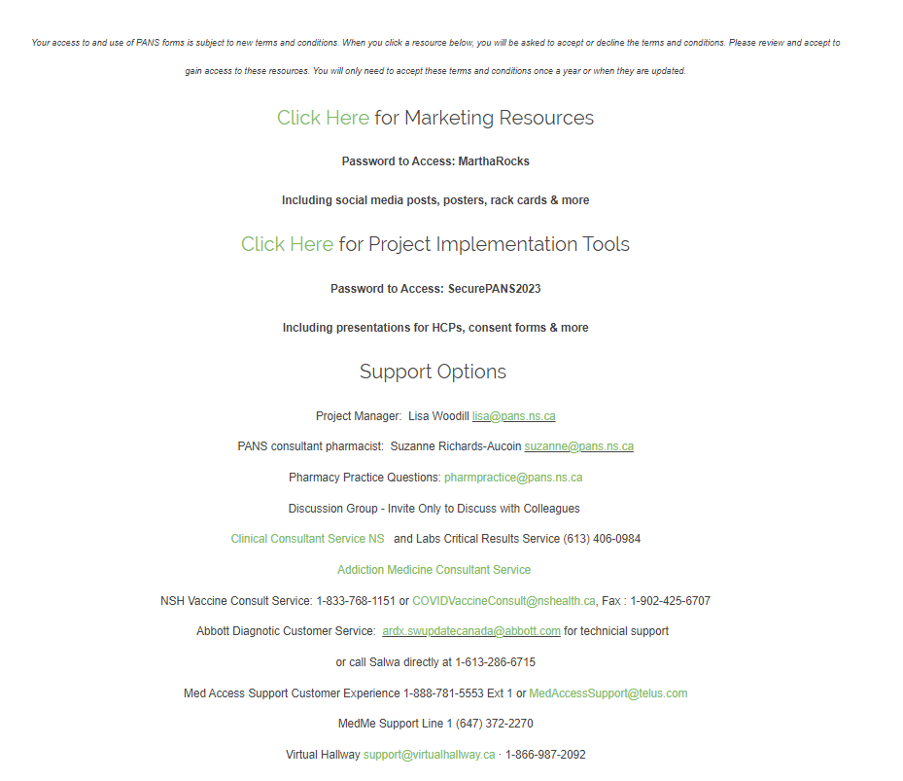
Project Resources: CPPCC website
Notes:
Project is not limited to those without a family physician, but is intended to help support this population. Pharmacists can also provide care within their scope, to reduce emergency room visits and free up appointment times at physician offices for appointments that are not within pharmacist scope (diagnostic/physical exams).

Slide 12
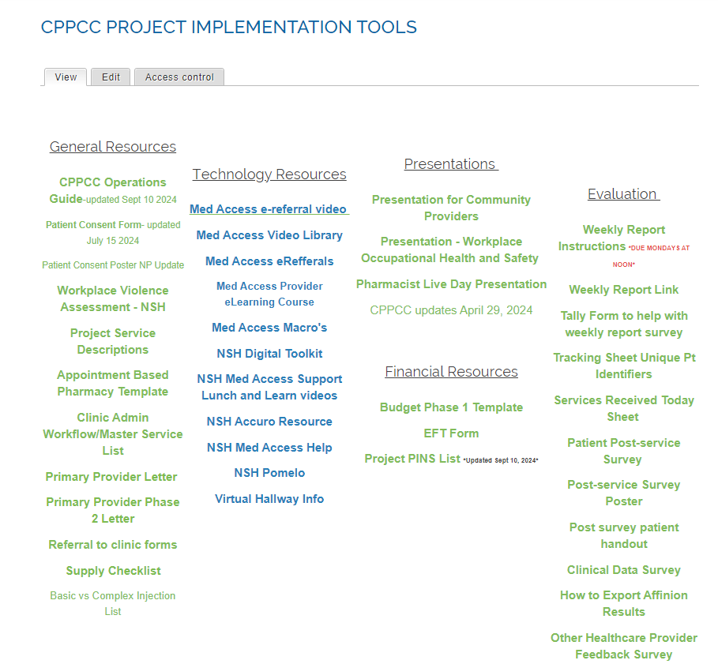

Slide 13
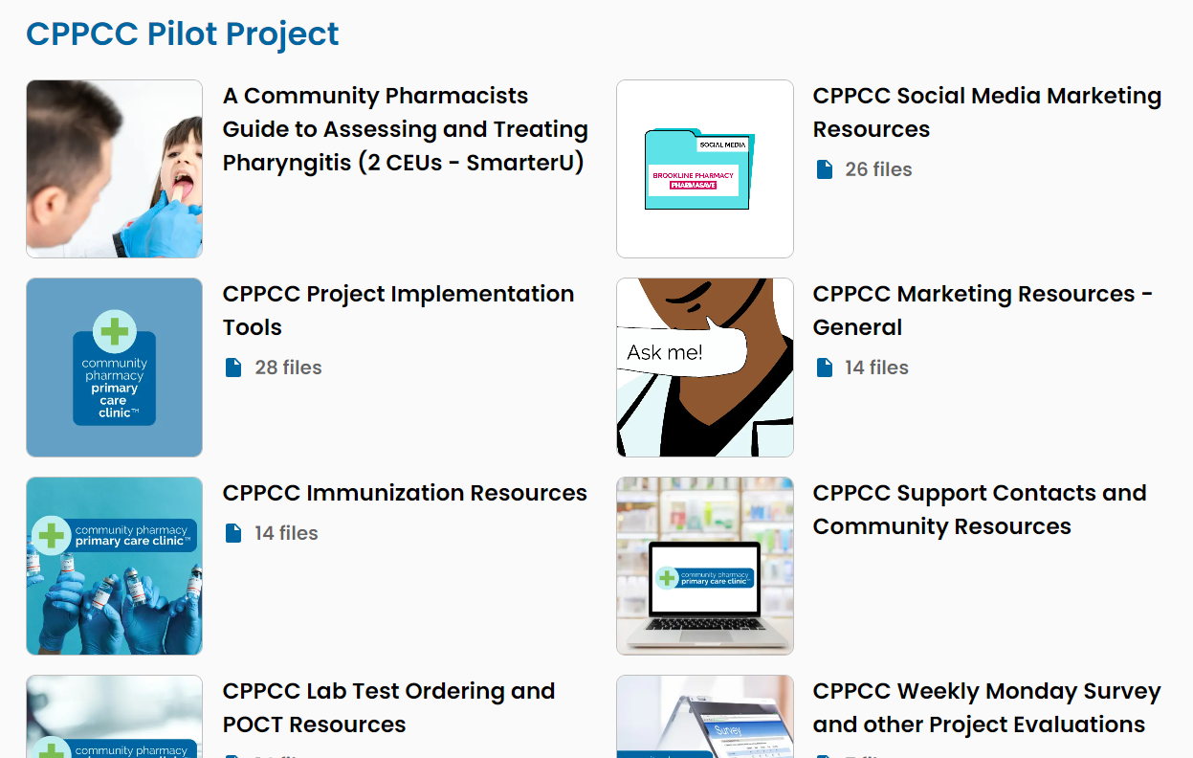
Resources: MemberLounge
https://pans.memberlounge.app/

Slide 14
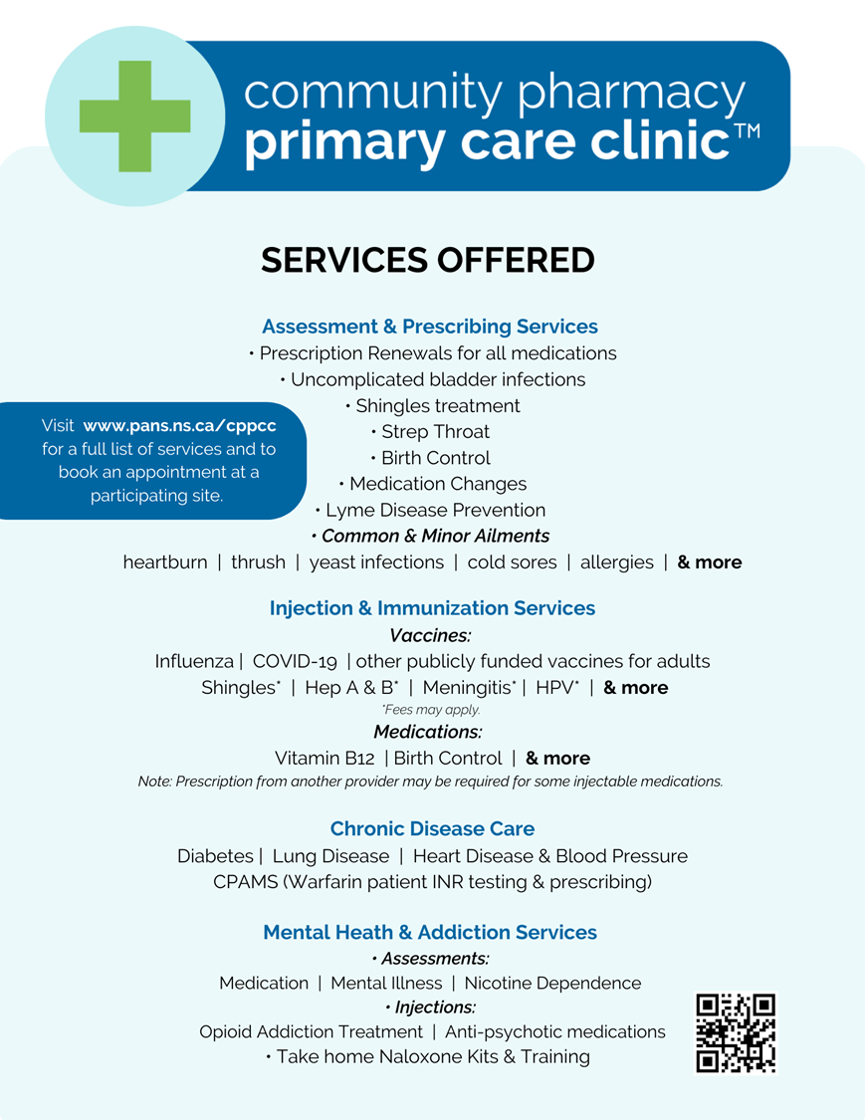
Notes:
These are the services offered. Chronic disease care includes a review of all medications for the condition. Pharmacists can adapt, substitute, start new medications, taper or discontinue. It also includes review of non-pharm or lifestyle factors that support patient meeting goals, use of devices (BP, glucose) to monitor their condition and/or POCT A1C and lipids if the patient is due.

Slide 15
Therapeutic Substitution
Rx Renewal
Adaptation
Based on assessment (efficacy and tolerability, review of SHARE, DIS, current relevant health status etc)
Includes CDSA meds for chronic conditions (excludes acute care)
Change in formulation, regimen, dose or duration of therapy to enhance drug efficacy/affordability/ tolerability
Changing the medication to enhance/maintain effectiveness of drug therapy, improve adherence, reduce cost, and supports treatment goals
Notes:
Therapeutic Substitution
- Sufficient information is obtained about the patient’s condition being treated, treatment goals, and prescribed drug for the pharmacist to ensure that the substitute drug has an equivalent therapeutic effect and supports the intended treatment goal; and • the therapeutic substitution will maintain/enhance the effectiveness of the patient’s drug therapy and/or improve adherence and will support the patient’s best interest with respect to financial, formulary, or payer considerations.

Slide 16
Common Prescribing Standards Questions
Notifications
Communication of assessment and prescribing details to the primary care provider or specialist takes place when a pharmacist prescribes schedule 1 drugs unless:
• the pharmacist determines it would not be in the best interest of the patient to do so, or
• the pharmacist determines the prescribing activity would not reasonably be expected to impact or inform the future care plan or clinical decision-making process by the primary care provider or specialist.
If a decision is made not to communicate to the primary care provider or specialist, the rationale for not doing so is documented in the patient record along with the prescribing and assessment details.
Renewals
The standards no longer indicate a specific duration. Pharmacist discretion.
Billing – required to renew as per previous durations unless there is a clinical reason to change duration
Think- is there a reason another provider would not renew for 90 days by 3 refills
CAN do an adaptation or therapeutic sub at the time of renewal
CAN renew CDSA Medications – up to 30 days at a time and CAN reassess at near 30 days and renew again. Exception Acute Pain Meds ,CANNOT renew. OAMT- see standards.
CAN prescribe without bloodwork, but may wish to prescribe shorter duration and then re-assess
Follow-up plan CAN include determining when it is appropriate to provide pt advice on when to follow-up
Therapeutic Substitutions
Can substitute to a different class of medication
For participants in the CPPCC project only – CAN also add medications for diabetes, asthma, COPD, and cardiovascular disease (research project approved by NSCP)

Slide 17
UTI – assessment and prescribing
Herpes Zoster – assessment and prescribing
Lyme Disease prevention
And Treatment
COVID-19
Cough
Assessment and prescribing: non-severe symptoms onset <14 days for 18> yrs
Medication is paid by patient
Treat uncomplicated UTI for >16 yrs females
Must be diagnosed prev. by MD/NP
Infrequent (none in past 6m, <3 in past year)
Shingles rash for <72h
Initiate treatment and refer to MD/NP if complicating factors present (ophthalmic, otic, neurologic, etc)
Prophylaxis-Black-legged tick bite within 72h, tick attached for at least 36h
Early Lyme treatment with Erythema Migrans rash

Slide 18
Common Prescribing Standards Questions
Minor Ailments
CAN prescribe any medication appropriate for the ailment (caution MedSASK is missing some options or says to refer as SK standards limit prescribing to specific meds)
Prescribing by Protocol
Herpes Zoster – CAN prescribe anti-viral medication when patient has ocular/auricular/neurologic involvement – just need to ALSO refer for further care
COVID-19
CAN prescribe budesonide as per protocol for covid-19 cough
Lyme Disease
CAN prescribe without seeing tick if confident it was a black legged tick. Standards say must be competent to identify the tick in general but not see the tick
CAN prescribe if patient has erythema migrans rash – this is new scope
CANNOT order blood work as not indicated for early lyme

Slide 19
Vaccines
(publicly funded)
Bloom Program
Anticoagulation Management service (INR testing and assessment)
COVID-19
Influenza
Meningococcal B (if at high risk)
Pneumococcal 65+
One-on-one care
Must have a drug therapy problem
Mental health and addictions assistance
Finger prick blood test
Hospital grade device
Dose adjustment/follow up
Contact/notify provider
Follow guidelines for referral to ER if needed
Participating Pharmacies
https://pans.ns.ca/cpams

Slide 20
Hormonal Contraception Management
Naloxone Home Kit Management
Medication Reviews
Public Health Initiatives- Close Contacts
1x/calender yr + followup in 3m for new Rx, or when changes needed
Includes counseling on STBBI, community supports, and more
IUD- need to collaborate
Invasive Group A Streptococcal Disease (IGAS)
Invasive Meningococcal Disease (IMD)
Pertussis
Kits are free of charge
Training/educating patients how to use kits
Anonymous- no name required
Basic: covered for Pharmacare patients
Advanced: covered for 65+ yrs and on Pharmacare
Co-pay may apply
Notes:
Medication reviews – have a number of providers – physicians and NPS referring patients for this service. Often when large number of meds, support with deprescribing, determine if medications may be causing therapy problems etc.

Slide 21
Acute Conditions/Minor Ailments
GI
Diarrhea (non-infectious)
Heartburn/Reflux
Hemorrhoids
Nausea
INFECTIONS
Bladder Infections
Shingles
Strep Throat
Vaginal yeast infections
Fungal infections of the skin
Impetigo
Cold Sores
Lyme disease chemoprophylaxis
Bacterial conjunctivitis
SKIN CONDITIONS
Acne (mild)
Calluses and Corns
Contact Allergic Dermatitis
Dandruff
Eczema (mild to moderate)
Fungal Infections of the Skin
Hives (mild)
Impetigo
Warts (excluding facial and genital)
OTHER
Dry Eye
Joint Pain (minor)
Muscle Pain (minor)
Birth Control
Smoking Cessation
Pinworms
HEAD/ NOSE/ THROAT
Allergic rhinitis and conjunctivitis
Headache (mild)
Oral Thrush
Oral Ulcers
Notes:
HEAD/ NOSE/ THROAT
Allergy Symptoms including the eyes and nose
Headache (mild)
Oral Thrush
Oral Ulcers
Sore Throat
REPRODUCTIVE HEALTH
Birth Control
Dysmenorrhea (menstrual cramps)
Emergency Contraception
Vaginal Yeast Infections
SKIN CONDITIONS
Acne (mild)
Calluses and Corns
Contact Allergic Dermatitis
Dandruff
Eczema (mild to moderate)
Fungal Infections of the Skin
Hives (mild)
Impetigo
Warts (excluding facial and genital)
OTHER
Dry Eye
Joint Pain (minor)
Muscle Pain (minor)
Sleep Disorders (minor)
Smoking Cessation
Threadworms and Pinworms

Slide 22
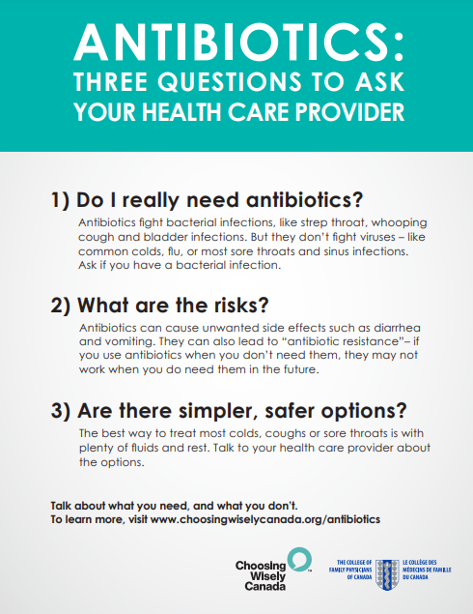
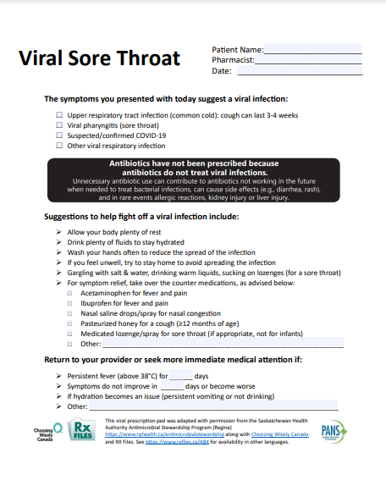
Pharyngitis Assessments- Group A Strep
Must take 2 hour PANS course on-line, practice with colleagues, training on the device
Don’t advertise the ‘test’. Patients that present as viral may not warrant a test. When signage/booking pages mention a test, it is expected.

Slide 23
Smoking Cessation Service
Behavioural counselling
Creating a plan
Recommending nicotine replacement therapy/Prescribe Medication
Follow-up visits.
Patients have 2 Options:
Assessment and Prescribing of Medications to Reduct or Quit Nicotine Products.
Comprehensive Support Program

Slide 24
Chronic Disease Management
Diabetes
COPD
Asthma
Mental Health
High blood pressure and hyperlipidemia

Slide 25
Medication Management
Basic medication reviews (less common in clinic)
Advanced medication reviews (Pharmacare seniors)
Complex medication reviews available at CPPCC sites only (those patients being referred by another provider for a review, or un-attached patients with a need for a review)
Notes:
Note: prescribing new medications is approved as a research project only for diabetes, COPD, asthma, CVD
Bring list of minor ailments

Slide 26
Chronic Disease Management
This is a longitudinal service which starts with a longer initial assessment visit along with follow up visits throughout the year (frequency depends of patient needs) to provide support/care for patients with diagnosed chronic diseases that need help managing their disease.
Hypertension, Dyslipidemia
Diabetes Mellitus,
COPD, Asthma,
Obesity
Non-cancer chronic pain
ADHD
Other

Slide 27
Chronic Disease Management
This is a longitudinal service which starts with a longer initial assessment visit along with follow up visits through out the year (frequency depends of patient needs) to provide support/care for patients with diagnosed chronic diseases that need help managing their disease.
The outcome of the initial assessment is to create a care plan, identify any health or drug therapy problems, make recommendations, prescribe changes or collaborate with family physician/NP when warranted and then follow the patient to resolve the problems and assist in meeting their goals. This incudes non-pharmaceutical or healthy lifestyle counselling support, system navigation and more. A template for topics to be covered is available.
It is not a medication renewal. Often identified during a renewal as a patient that has DRPs, not meeting targets, not being followed, or requires additional support.
Recommend call to book to determine if the patient needs a renewal service or would benefit from CDM.

Slide 28
Injection FAQ
Basic – Bill to MSI using CPPCC PIn
Complex – Bill Basic + complex PIN to MSI
Publicly funded vaccine Injection
Basic – Add to CANImmunize
Complex –If meets criteria, Bill PIN to MSI
Non-publicly funded vaccine injection
Medication Injection
Patient pays (bill private plan or pays cash)

Slide 32
Ordering Laboratory Tests
Pharmacists ordering lab tests was enabled by scope of practice in 2013, however they are just starting to be added as providers to the NSH Lab System
Pharmacists in this pilot are the first group of pharmacists with this access.
Pharmacists can order tests that are recommended for initiation or monitoring of drug therapy. Pharmacists will receive results via fax and/or EMR.
Results will be in SHARE for other providers to access.
Family physician/NPs must be notified when results are out of range and any prescribing actions taken by the pharmacist
Ensure all pharmacists have taken the U of Sask course and sent in forms as will take up to 3 weeks to set up (
Fax results and e-results

Slide 33
Ordering Laboratory Tests
When ordering a test, need to think about what you will do with the results, will it be clinically relevant, why is the monograph recommending it, will you make a change as a result
Need a system to review and respond in a timely manner. Think about vacation times, pharmacists that may only be scheduled once per week
Need scheduled time in day to review results.
How will you handle normal results?
Abnormal results -Pharmacist Clinical Consult Team is available to provide guidance as you learn how to manage abnormal results
All critical values are reported to the Pharmacist Clinical Consult team to be discussed with the pharmacist (during clinic hours) or directly with the patient (if after hours)
Patients can now access results on Your Health NS app

Slide 34
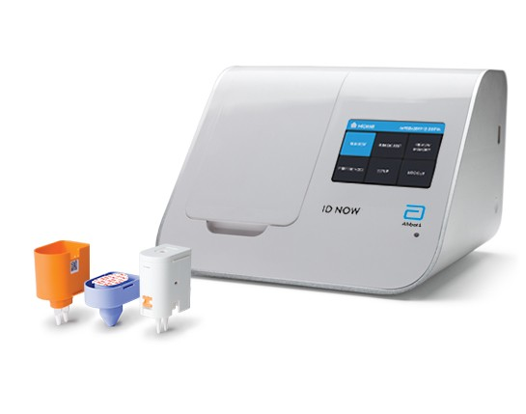
Point of Care Testing
Testing Service alone is not advertised. Intended to be a tool to be used in provision of care.
Afinion HbA1c
Afinion Lipid Panel
ID NOW Group A Strep
Coaguchek Pro II

Slide 35
Patient Information
Who can book?
This project will allow patients of the pharmacy along with non-patients to book appointments with the clinic. There is no charge for assessments for patients with a NS Healthcard.
Community providers such as the Emergency room, walk-in clinics, diabetes clinics, primary care clinics physician or NP offices can request signage/handouts/business cards that include types of services and info on how to refer patients to book.
Can be attached or unattached patients.
Booking appointments
People who have ailments/conditions that fit the criteria can book an appointment through the online booking portal, or they can call the pharmacy directly to schedule an appointment. There will be time set a side each day for “same day” visits on conditions that are time sensitive.
Patient Consent
Before entering the clinic for the first time, the patient will be presented a patient consent for to read and sign. It will explain the nature of this project, that it is part of a study being conducted jointly by the Nova Scotia Department of Health and Wellness, Nova Scotia Health, and the Pharmacy Association of Nova Scotia. The consent form outlines what the patient can expect, costs associated, the personal information that will be collected, how that information will be used, along with what measures the clinic/project will do to keep personal health information private.

Slide 36
Support Options
Project Manager: Lisa Woodill lisa@pans.ns.ca
PANS consultant pharmacist: Suzanne Richards-Aucoin suzanne@pans.ns.ca
Pharmacy Practice Questions: pharmpractice@pans.ns.ca
Discussion Group - Invite Only to Discuss with Colleagues
Clinical Consultant Service NS and Labs Critical Results Service (613) 406-0984
Addiction Medicine Consultant Service
NSH Vaccine Consult Service: 1-833-768-1151 or COVIDVaccineConsult@nshealth.ca, Fax : 1-902-425-6707
Abbott Diagnotic Customer Service: ardx.swupdatecanada@abbott.com for technicial support
or call Salwa directly at 1-613-286-6715
Med Access Support Customer Experience 1-888-781-5553 Ext 1 or MedAccessSupport@telus.com
MedMe Support Line 1 (647) 372-2270
Virtual Hallway support@virtualhallway.ca · 1-866-987-2092

Slide 37
Nurse Practitioner Program
As of July 2024, NSH has partnered with PANS to provide 3 Nurse Practitioners designated to work with CPPCC pharmacists. The list of areas to consult keeps expanding, but current topics include patients with:
Hypertension and dyslipidemia
COPD and Asthma
Diabetes
Chronic kidney disease
Thyroid disorder

Slide 38
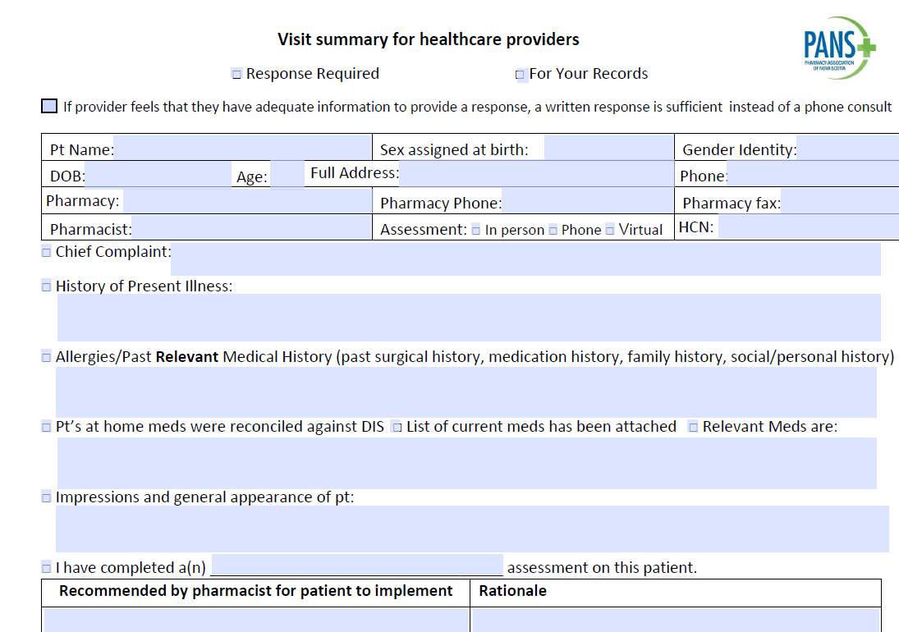
Virtual Hallway Communication pathway with CPPCC-NP https://app.virtualhallway.ca/
All cppcc staff should have/or in the near future will receive emails from Virtual Hallway to set up an account. These are time sensitive to access the link within 48 hours to sign.
This is how you book an appointment to speak with NPs
You are required to upload the patient’s consultation summary and PANS form for diagnosing HTN or T2D if they is why you are booking in
NP will call you (at phone line provided when booking) at apt time
Virtual Hallway Demo Video

Slide 39
What to do when symptoms are out of pharmacist’s scope?
→ If within list of consultable services, phc can discuss with CPPCC-NP who can diagnosis/refer/give advice
Patients with a Family Physician
Referral to Family Physician
Attached patients that require assessment for an undiagnosed condition (which can wait until next available appointment)
Attached patients that require specialist referral
Attached patients that require annual or usual care physical assessments, tests ordered such as EKG etc., as part of chronic disease management
Referral to Walk-in Clinics
If patient requires non-urgent care and is unable to obtain an appointment with family physician in recommended time frame will be referred to walk-in (ex. requires physical assessment for otitis media)
If Urgent Referral to Emergency Room (ER)
Any patient (attached or unattached) that requires urgent medical treatment
Patients without a Family Physician
Referral to Virtual Care NS
Unattached patients that require assessment for an undiagnosed condition, but may not require in person visit (ex. depression, anxiety etc)
Unattached patients that may require specialist referral
Referral to Primary Care Clinics or Walk-in Clinics
Unattached patients that require assessment for an undiagnosed condition that will likely require physical assessment
Unattached patients that require annual or usual care physical assessment, tests ordered such as EKG etc. as part of chronic disease management
If Urgent Referral to Emergency Room (ER)
Any patient (attached or unattached) that requires urgent medical treatment

Slide 40
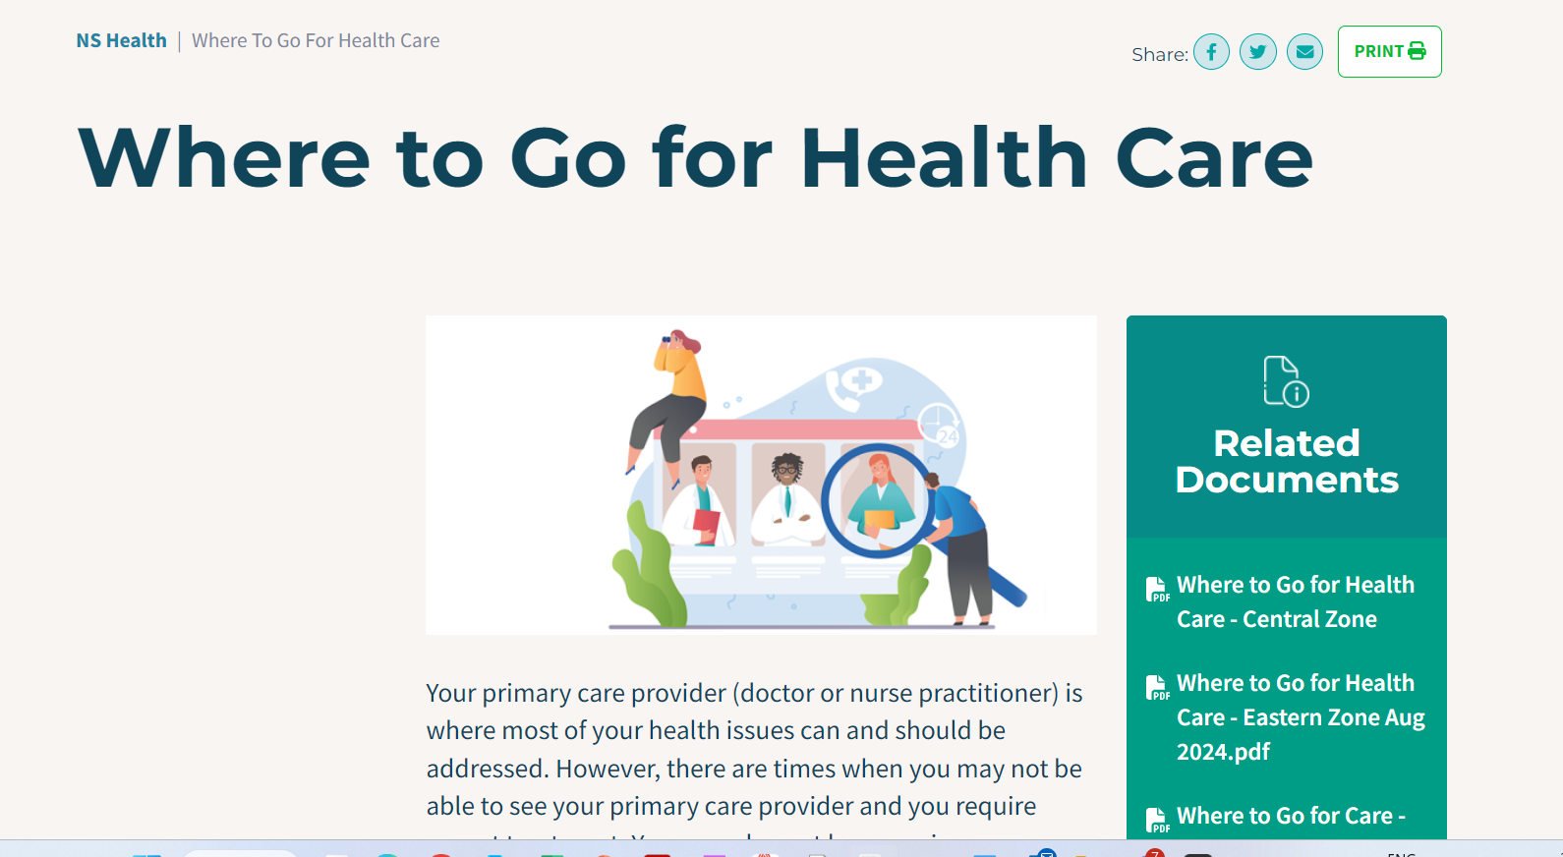

Slide 41
Communicating with Patient’s Provider(s)
Notes:
As per NSCP Standards for Prescribing and Testing, pharmacists are required to notify a patient’s family physician/NP of all test results and prescribing. During this project, this requirement will be satisfied by sending a fax communication

Slide 42
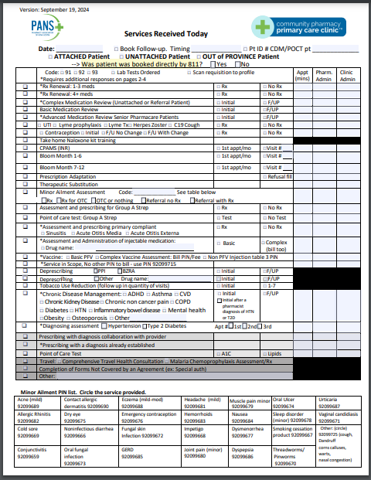
Billing

Slide 43
What Do I Bill for CPPCC?
A patient comes in for a renewal and you determine you need to adapt the dose
A patient comes in for a renewal of 3 medications and you determine you need to adapt the dose of one
Bill the adaptation PIN for the one medication
Bill the renewal 1-3 meds PIN for the other two medications
Patient comes in for a CDM, Med Review or Bloom Service and requires a renewal of medications
Bill the primary service the patient received (ex. CDM Diabetes). This would include renewals for their diabetes medications
Patient comes in for a CDM Diabetes and lets you know they also need their 2 inhalers and Synthroid renewed.
Bill the primary service the patient received (ex. CDM Diabetes). This would include renewals for their diabetes medications
Bill a renewal PIN for 1-3 meds for 2 inhalers and thyroid. This is a different assessment that wasn’t covered as part of your CDM diabetes service.
Patient comes in for a service (ex. Med Review, renewal, CDM, Bloom) and the pharmacist exercises project scope to prescribe a new additional medication for diabetes, COPD, asthma or CVD
Bill the primary service the patient received (Ex. CDM Diabetes)
Also bill the PIN for Prescribing with a diagnoses confirmed by pharmacist and change the fee to $0 ($0 if the assessment was completed as part of primary service)

Slide 44
What Do I Bill for CPPCC?
Patient comes in for a service (Renewal, Med Review, CDM, Bloom) and requires POCT for A1C or lipid panel
Bill the primary service the patient received
Bill the POCT PIN (this is above and beyond usual care in this service)
Patient is on CPAMS and requires a renewal on their warfarin prescription
Complete a renewal assessment and bill the renewal PIN (up to once per year)
Continue to see patient for POCT, and assessments at interval recommended at most recent appointment
A patient books an appointment for a renewal and it is apparent that a number of medication therapy problems are present.
Bill the renewal Pin if able to collect adequate information to complete the renewal for a limited duration
Book the patient to come back for the appropriate service (CDM, Med Review if Pharmacare, or Complex Medication Assessment

Slide 45
Pharmacy Dispensary Service vs CPPCC
If a patient presents after clinic hours but dispensary is open and requires a service that cannot wait until an appointment is available at the clinic, and the dispensary team has the time, the pharmacy should proceed with offering the service and bill using the usual PINS. DO NOT USE CPPCC PROJECT PINS
If a patient presents after hours and requires a service which can reasonably wait for the next available appointment time, the dispensary staff should book them into the clinic

Slide 46
Other Frequently Asked Questions
Can we operate more than 40 hours per week?
Setting Up Booking Calendars
Table 2 Billings
Stipends

Slide 47
Clinic Admin Role
Booking
Take phone call questions and do phone bookings, create patient profiles for new patients (for now in both PMS and EMR)
Check-In
Greet patients and help them into private room when it is time for the appointment (ensure jackets off, ready to go when pharmacist comes in)
Sign Consent (if first time), document, scan, shred
Confirm patient file up to date (contact info, allergies, med conditions) and EMR for CDM, Advanced Med Reviews
Access SHARE and print or save for defined services
Confirm name of family physician/ unattached – document
If patient arriving for a vaccine, ensure CANImm consent forms are complete and if not complete with the patient (greeter function)
Post-appointment
- After the appointment, complete online billing for the appointment
Data Collection – Starting November 4th
Weekly reporting of hours of operation and hours worked
Bi-weekly Reporting of Services
NSCP research Projects documentation
Other
Clean rooms in between uses, ensure supplies required in the room are stocked (POCT, injection supplies, brochures, etc)
Maintain vaccine inventory – monitoring cold chain, place orders when inventory low
Reorder POCT inventory when low
Appointment No-shows- call patients booked later in day or next day for phone or virtual that may be able to take a call early

Slide 48
No appointments?
Ensure all pharmacy team members understand that a project requirement is that pharmacist and clinic admin scheduled for the clinic must focus on clinic activities and not jump back into pharmacy workflow.
Suggestions for times when there are no appointments booked:
Clean and tidy reception, waiting area and clinic rooms
Organize forms, catch up on any billing, fax physician forms etc.
Community outreach
Patient Follow-up
Reminder calls for the lengthier services if system doesn’t send a reminder email
Review Rx waiting for pick-up and add business card or marketing tool with service recommendations (last refill, contraception patients, 50+ for Shingrix etc)
Run reports to screen for eligible patients
Patients taking medications for mental health conditions that you know from conversations may meet criteria
Medications for chronic disease that may benefit from additional support
Patients eligible for medication reviews

Slide 49
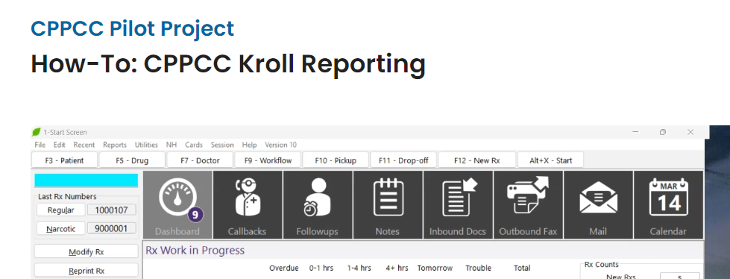
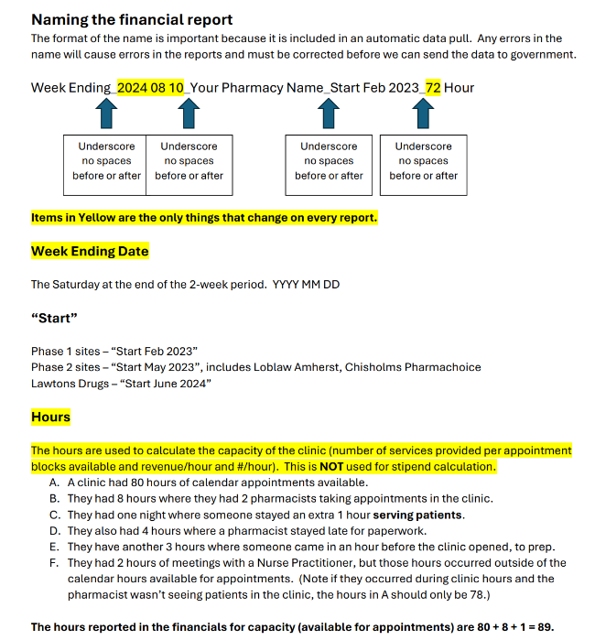
Data Collection: Financial Reports
These will be submitted every 2 weeks
(on a Monday)
Discuss with clinic lead/manager/owner
who will be doing this task
SDM is completed by head office.
Uploaded to a shared file
See video in Memberlounge on how to:

Slide 50
NSCP Research Projects

Slide 51
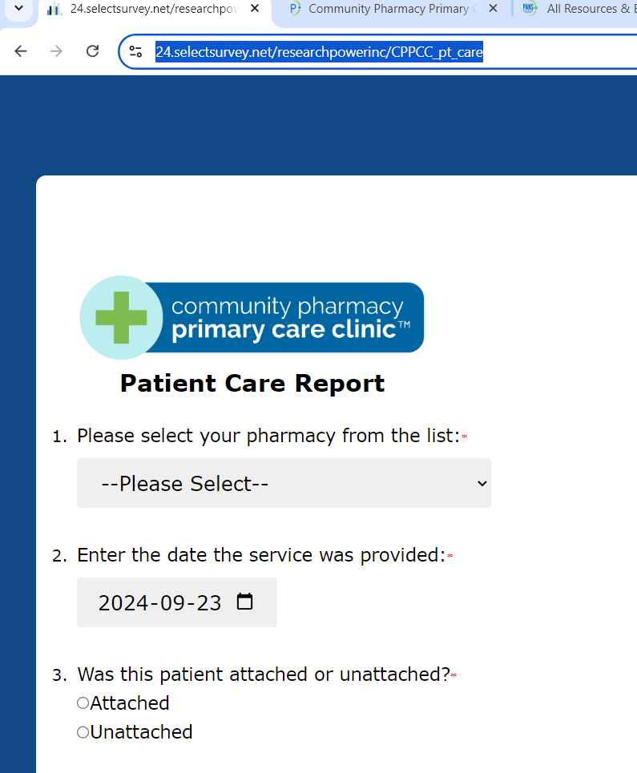
NSCP Research
https://24.selectsurvey.net/researchpowerinc/CPPCC_pt_care

Slide 52
Research Approvals
This is to confirm that the proposed additional scope for the PANS Community Pharmacy Primary Care Clinic Demonstration Project submitted on February 1st and February 12th has been conditionally approved by the NSCP Council under the Standards of Practice: Prescribing Drugs, Appendix I - Prescribing in Accordance with an Approved Research or Pilot Protocol. The additional scope includes:
Assessment and prescribing for any condition for which a diagnosis is established;
Diagnosis and prescribing for hypertension and diabetes; and
Phase 1 and 2 only Assessment and prescribing for sinusitis, otitis media, and otitis externa.
Please note that approval for the above scope is conditional on the following:
The Pharmacy Services Steering Committee must approve the addition of this scope for the PANS Community Pharmacy Primary Care Clinic Demonstration Project.
The NSCP must be involved in the leadership of the project, including membership on the Working Group that ensures that:
pharmacists who are participating have the competence to do so;
the system enables them to safely do so; and
the NSCP is effectively/appropriately able to oversee the researched practice activity so that we can intervene if necessary.

Slide 53
Conditions of Approval
Clinical Incident Reporting Tool (CIRT)
The objective of reporting using the NSCP Clinical Incident Reporting Tool (CIRT) is to engage in continuous quality improvement, and to gain and share learnings amongst Nova Scotian pharmacy professionals regarding clinical incidents and necessary safeguards.
For the purposes of reporting using the CIRT, a clinical incident should:
Be related to providing clinical care in a CPPCC clinic
Have reached or impacted a patient (i.e., not a near miss)
Reporting is anonymous and confidential. After submitting an incident, you can view a summary of your report and download a PDF for your records. The NSCP will also provide reports of aggregate data to CPPCC participants.
Please click here to access and report to the CIRT.
Note: Dispensing-related near misses and incidents should still be reported through CPhIR, The Patient Safety Company (TPSC), or Pharmapod.

Slide 54
Conditions of Approval
Competency Self-Assessment and Learning Tool (C-SALT)
The Competency Self-Assessment and Learning Tool (C-SALT) enables pharmacists to assess their competence to prescribe and identify their learning needs to maintain and/or improve their competence.
More information can be found in the User Guide on the first two pages of the tool. Pharmacists
CPPCC pharmacists must complete the C-SALT, including creating a learning plan and make a declaration (see below) no later than July 8, 2024.
CPPCC Pharmacist Declaration
To acknowledge that you have completed your C-SALT, and that you understand your responsibilities to continue to use the C-SALT and to report clinical incidents through the CIRT reporting tool, CPPCC pharmacists must complete and submit a declaration no later than July 8, 2024.
Note: You cannot make a declaration until after you have completed your C-SALT.
The completion of the C-SALT has been accredited for 3.0 CEUs. You will be provided with a certificate after completing your declaration.

Slide 55
Assessment and prescribing for any condition for which a diagnosis is established;
NSCP Council extended and expand the current research approval until September 30, 2024 to align with the current extension of the CPPCC project. This extension will not only ensure continuity of services already offered and promoted as available at all CPPCC location, but it will also allow PANS to continue to collect important evaluation and safeguard data related to:
pharmacist training and skills related to the assessment and management of chronic disease;
communication with other healthcare providers regarding pharmacist rationale for prescribing decisions and care plans that are implemented;
practice supports and opportunities for collaboration for patients with complex care needs; and
referral pathways when patients require additional care outside of the pharmacist’s scope of practice.
The expansion is to enable pharmacists to prescribe for any condition for which a diagnosis has already been established and for which it is within that pharmacist’s competence to prescribe. This ensures that the pharmacist is able to make treatment decisions that are consistent with guidelines and in the patient’s best interest.

Slide 56
Assessment and prescribing for any condition for which a diagnosis is established;
Ensuring that a diagnosis has already been established is acheved through a number of mechanisms:
Review of the patient’s history of medication treatment for the indication (ex. via DIS)
Appropriate measurement of target health metrics through review of lab test results (SHARE), and/or in-office measurements etc.
A discussion with the patient if the patient demonstrates an understanding of their diagnosis, and the pharmacist assesses that the patient has the competency to relay the history of their diagnosis.
Any other patient records available.

Slide 57
Diagnosis and prescribing for hypertension and diabetes
Enable pharmacists to diagnose and prescribe for hypertension and diabetes.
Diagnosis will be in accordance with a protocol based on recognized clinical practice guidelines and developed in conjunction with subject matter experts in diabetes and hypertension.
For these conditions, guidelines sometimes recommend additional baseline tests and/or exams. When these tests and exams are outside of the pharmacist’s scope, pharmacists can work with NPs to discuss if needed and to order and interpret.
In some cases, a review of potential secondary causes of the conditions may be needed. When identified by protocol they can work with the patient’s primary care provider, an NP for guidance and/or refer to other providers in the community.

Slide 58
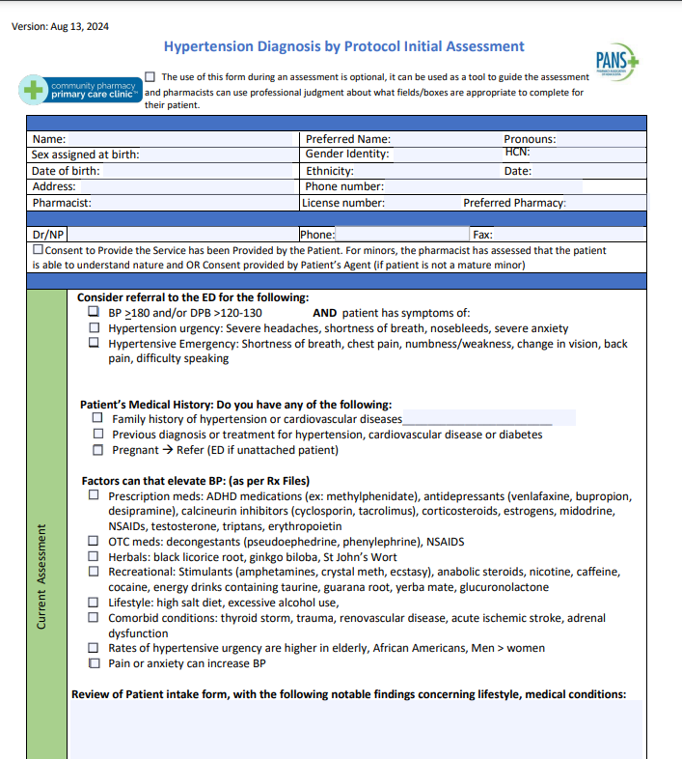

Slide 59
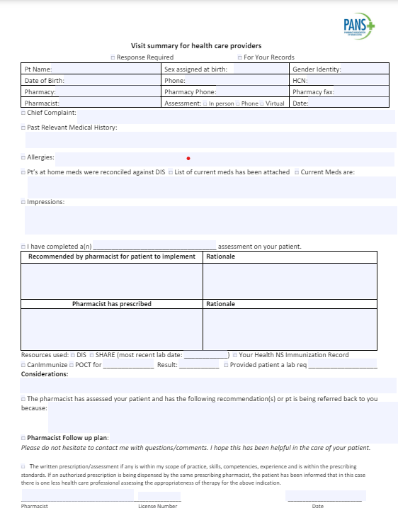
NP Case Studies and Peer Support

Slide 60
NP Case Studies

Slide 61
NP Case Studies

Slide 62
NP Case Studies

Slide 63
NP Case Studies

Slide 64
Evaluation
This is a project, and outcomes and data collection are very important. Need to reinstate all process
Clinical Data portal – all encounters

Slide 65
Site Visits
Opportunity for One on One Discussions
Hours of Operations
Staffing
Signage and Marketing Plan
Website/Calendar
Clinic Admin Station Set-up
Clinic Rooms Set up
Security Considerations
Budgeting/Planning
Any practice you would like

Slide 66
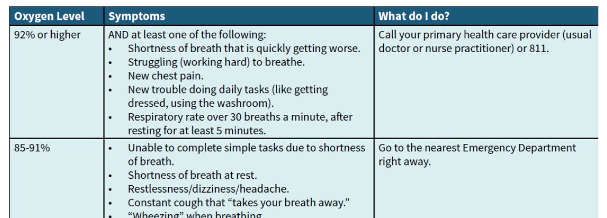
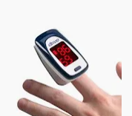
Oximeters
Have been provided by NSH non-severe covid treatment team
O2 Sat was added to hypertension/diabetes diagnosis protocols

Slide 67
Questions?

